Slide 1
Salesforce and Azure AD

Slide 2
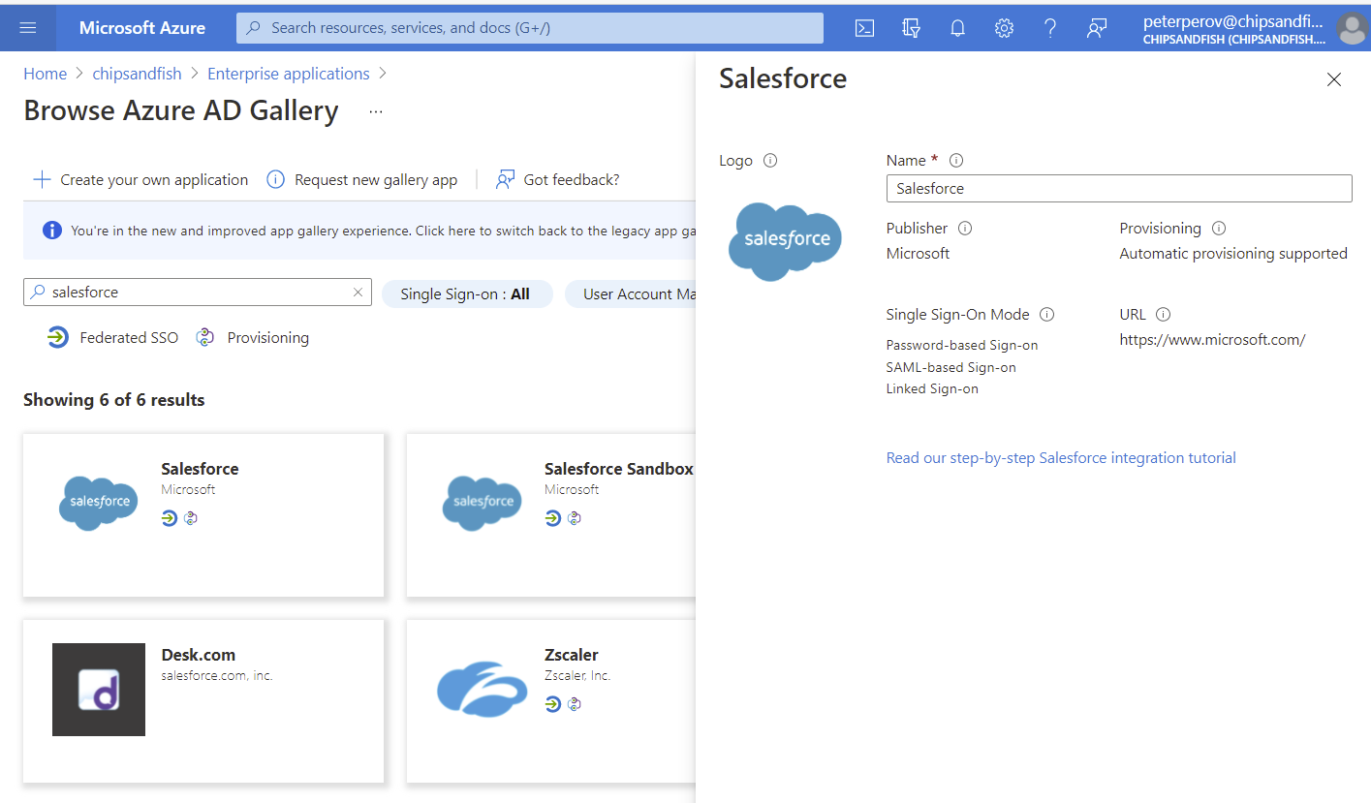
Add Salesforce App from the gallery

Slide 3
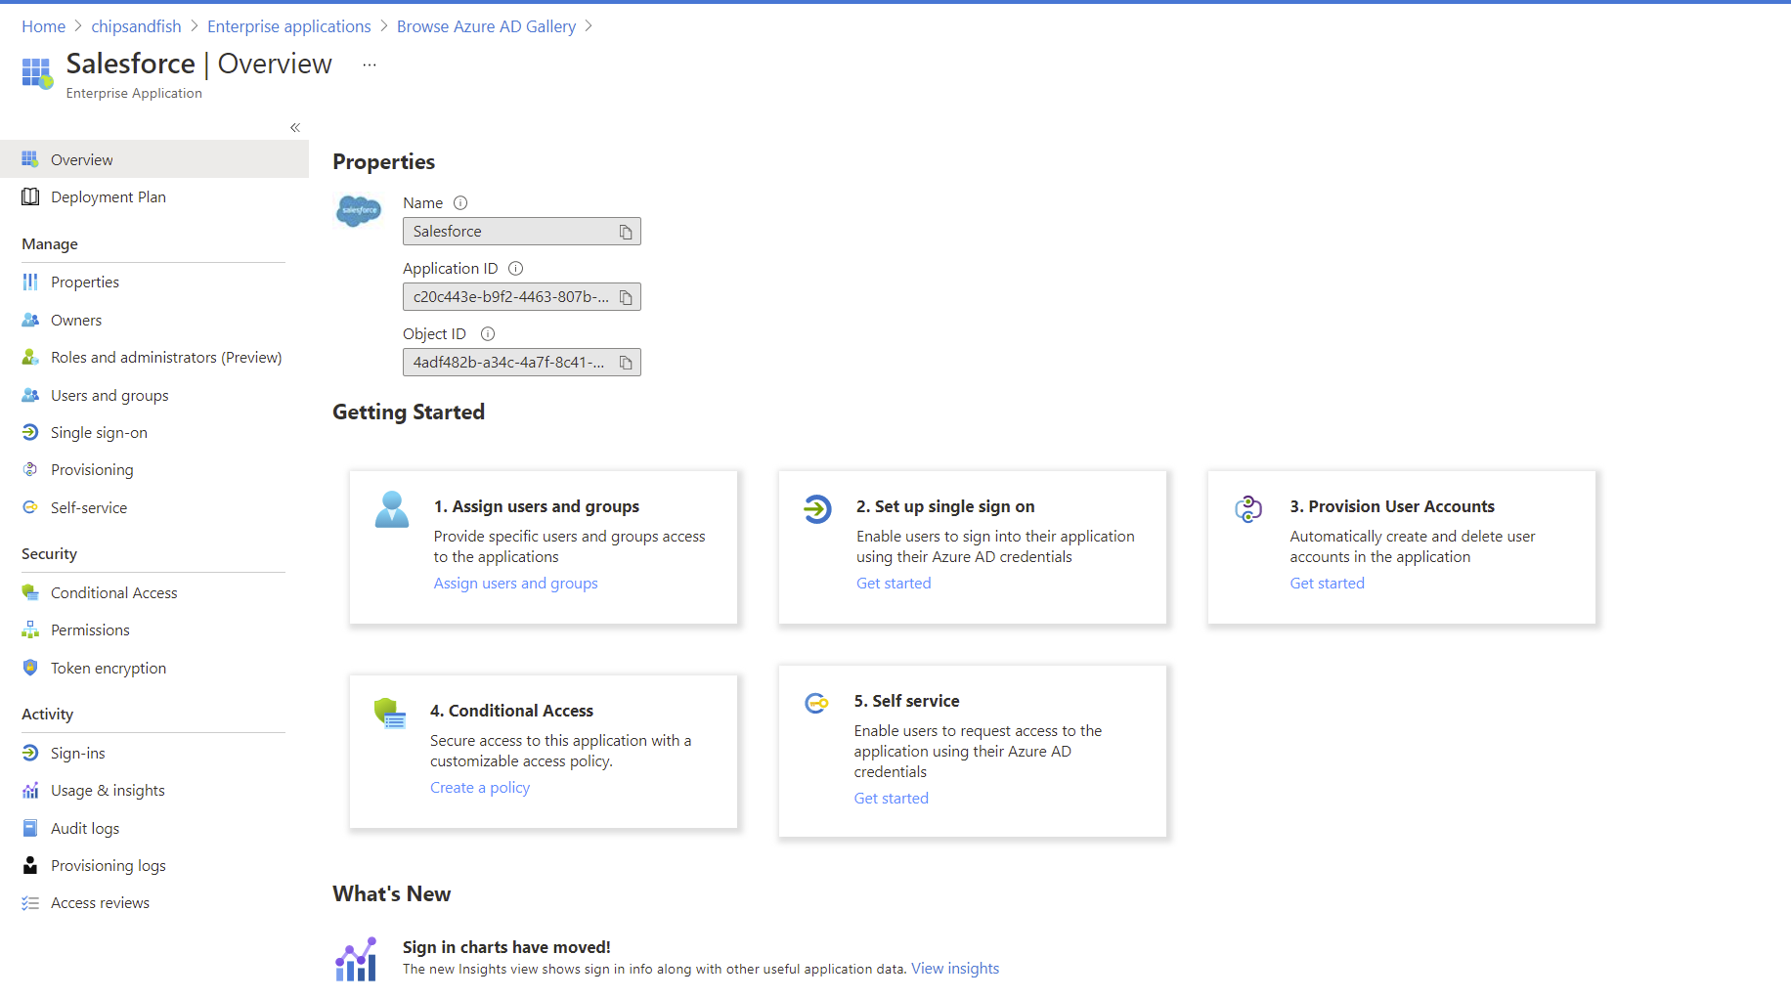

Slide 4
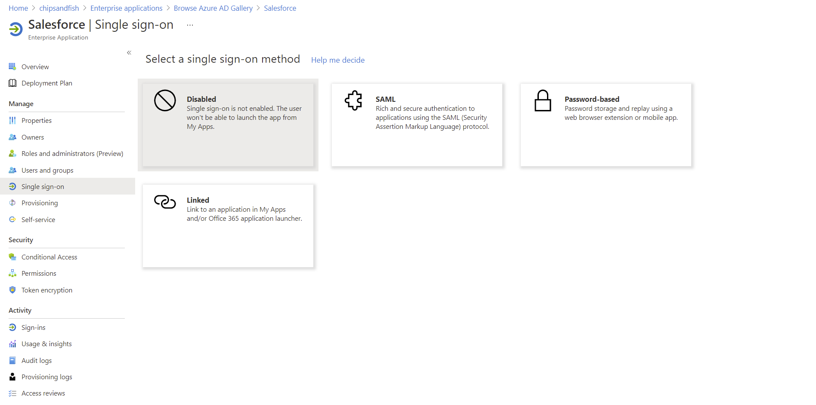

Slide 5
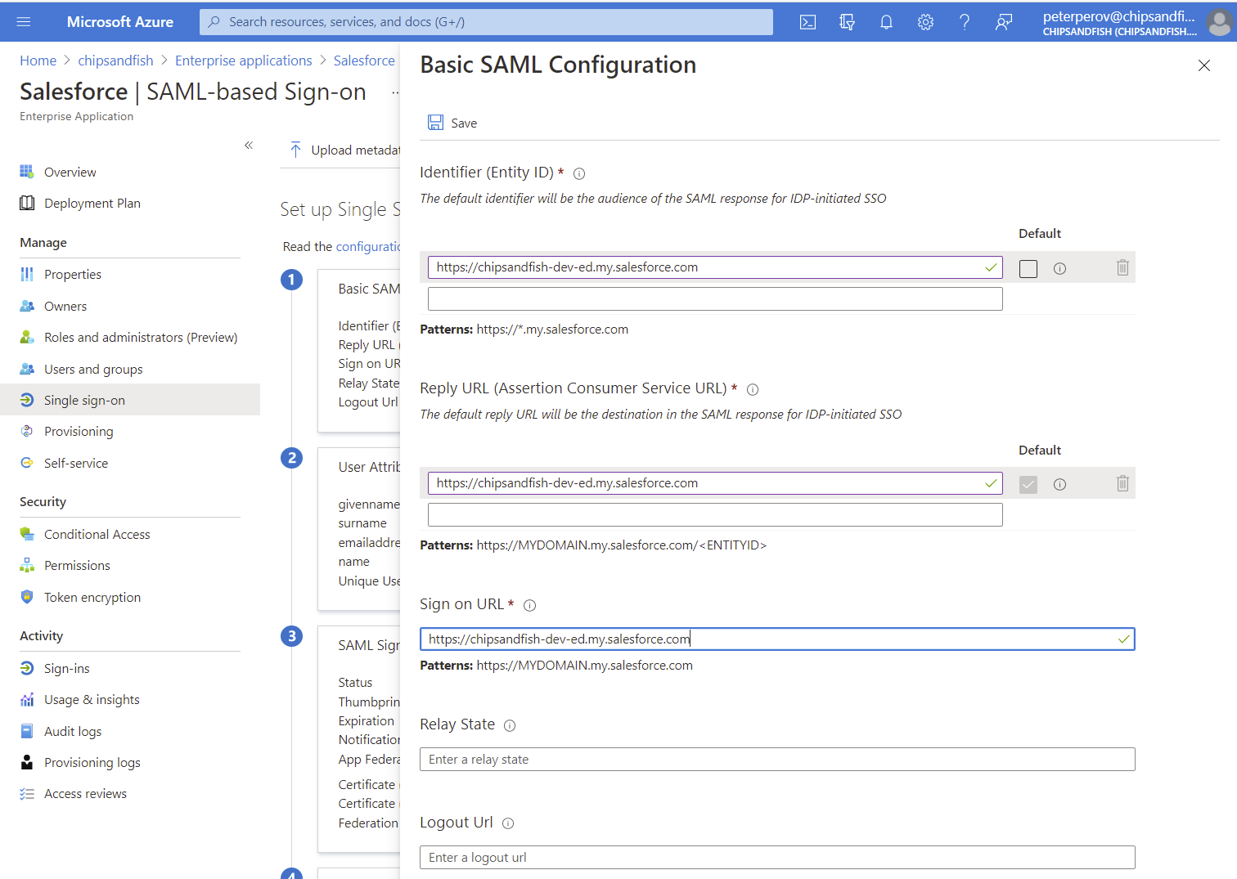

Slide 6
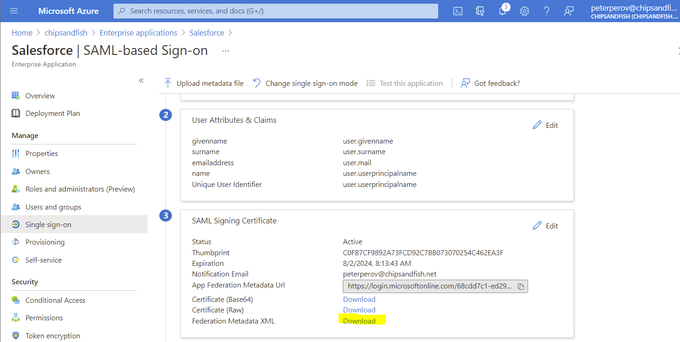

Slide 7
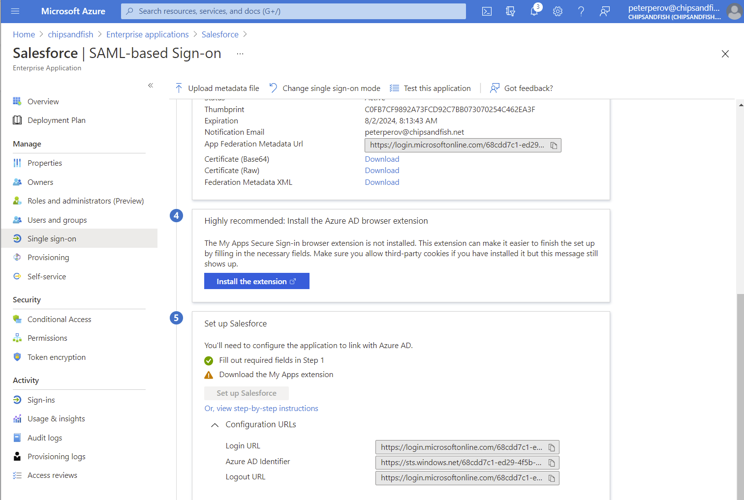

Slide 8
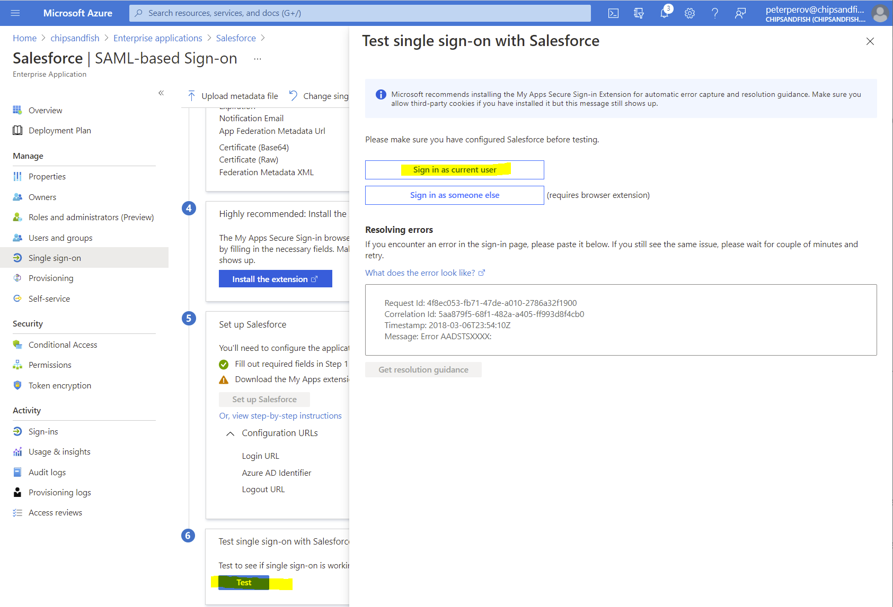
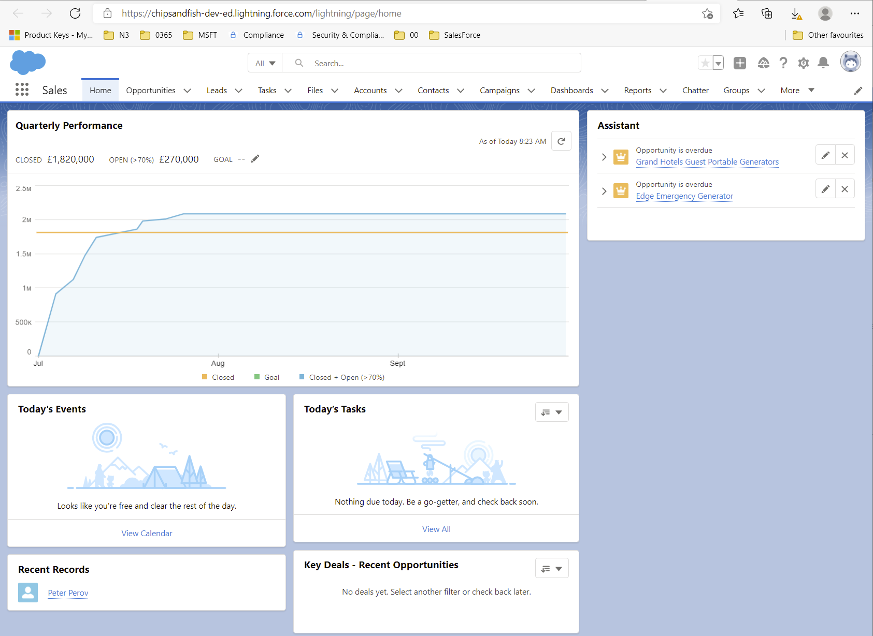
Testing

Slide 9
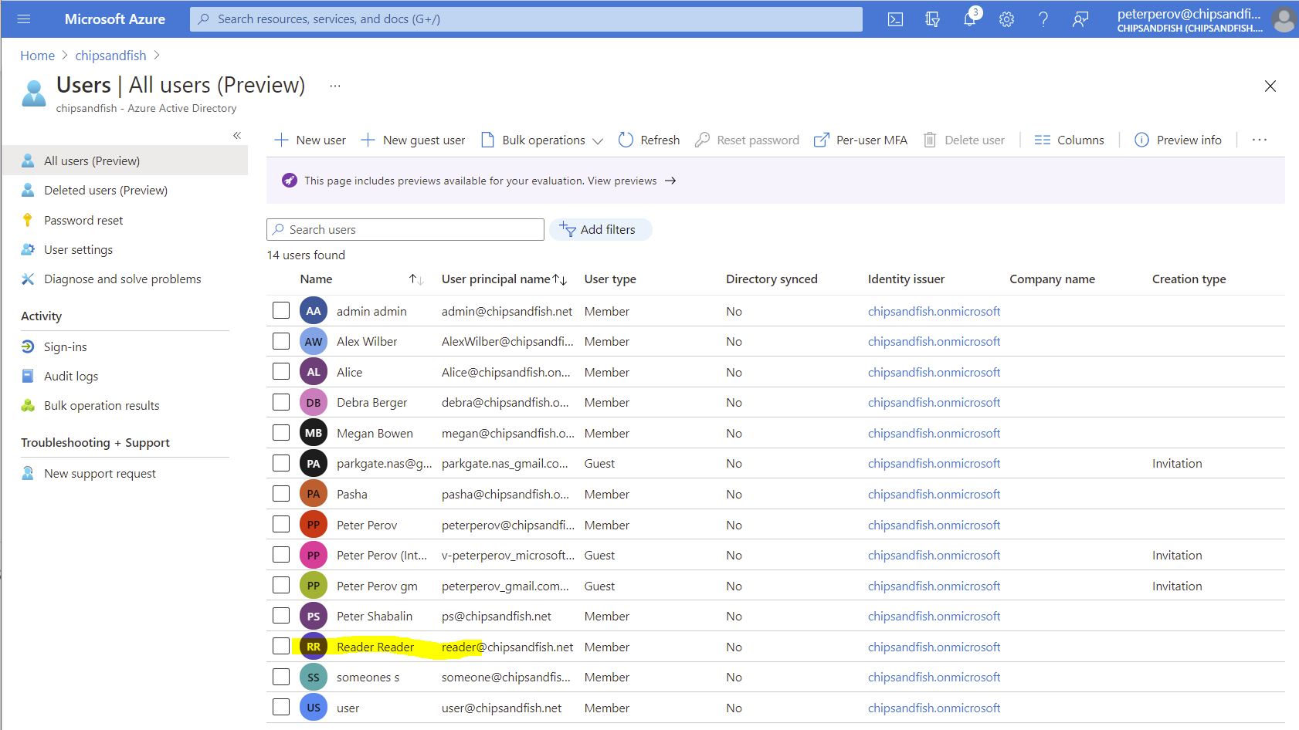

Slide 10
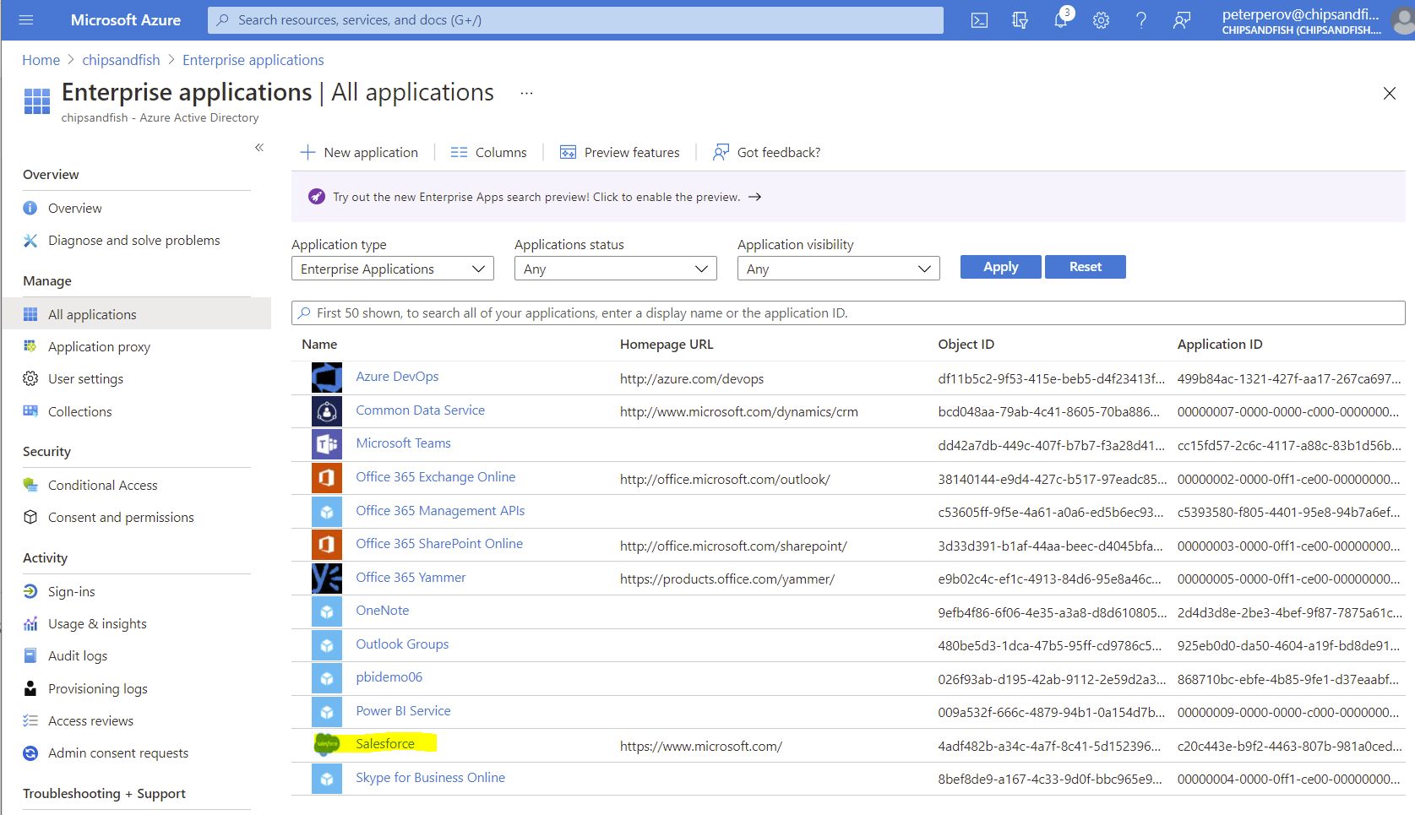

Slide 11
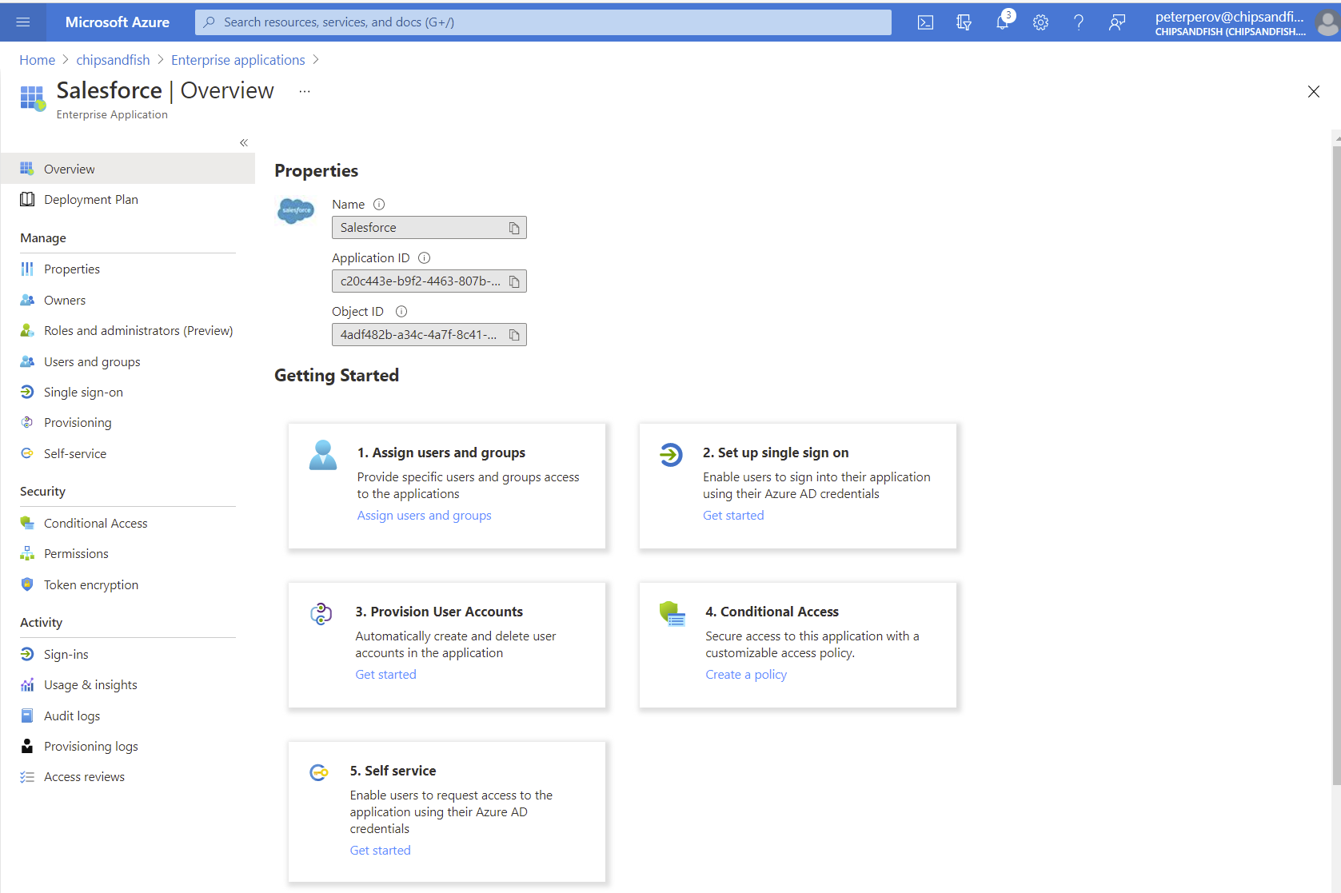

Slide 12
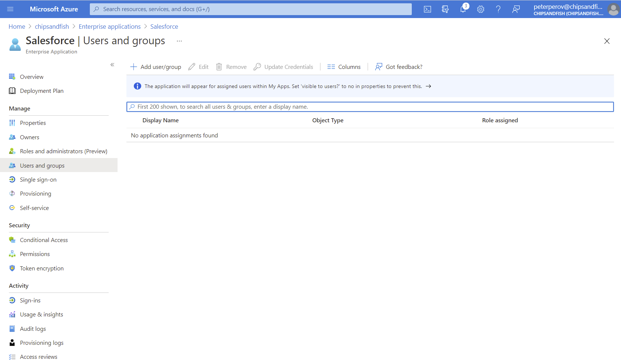

Slide 13
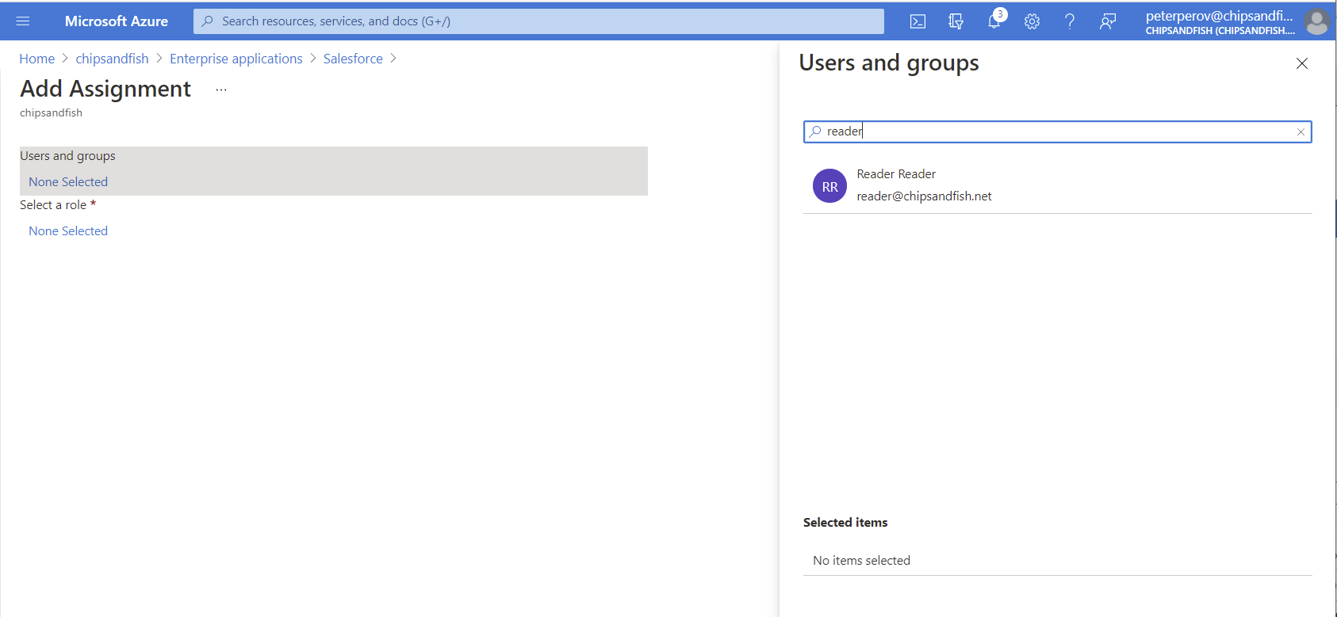
Add User

Slide 14
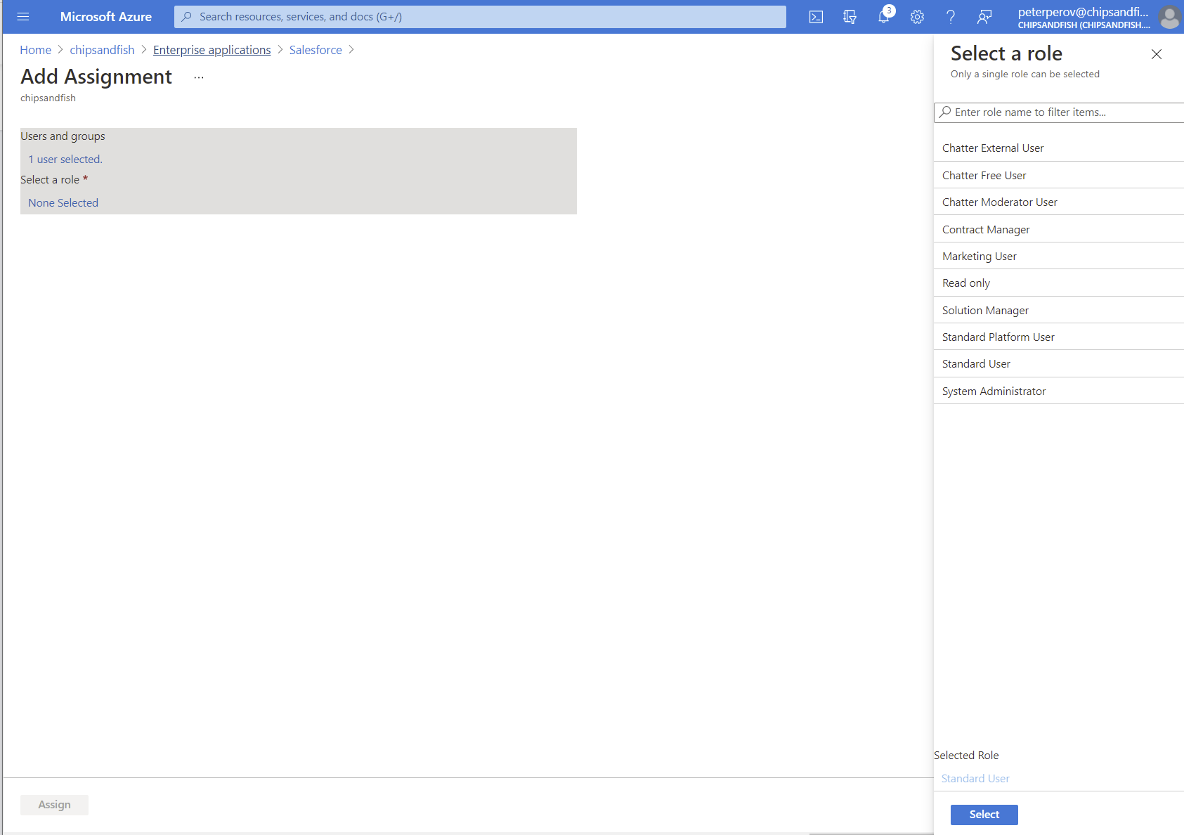
Add Role

Slide 15
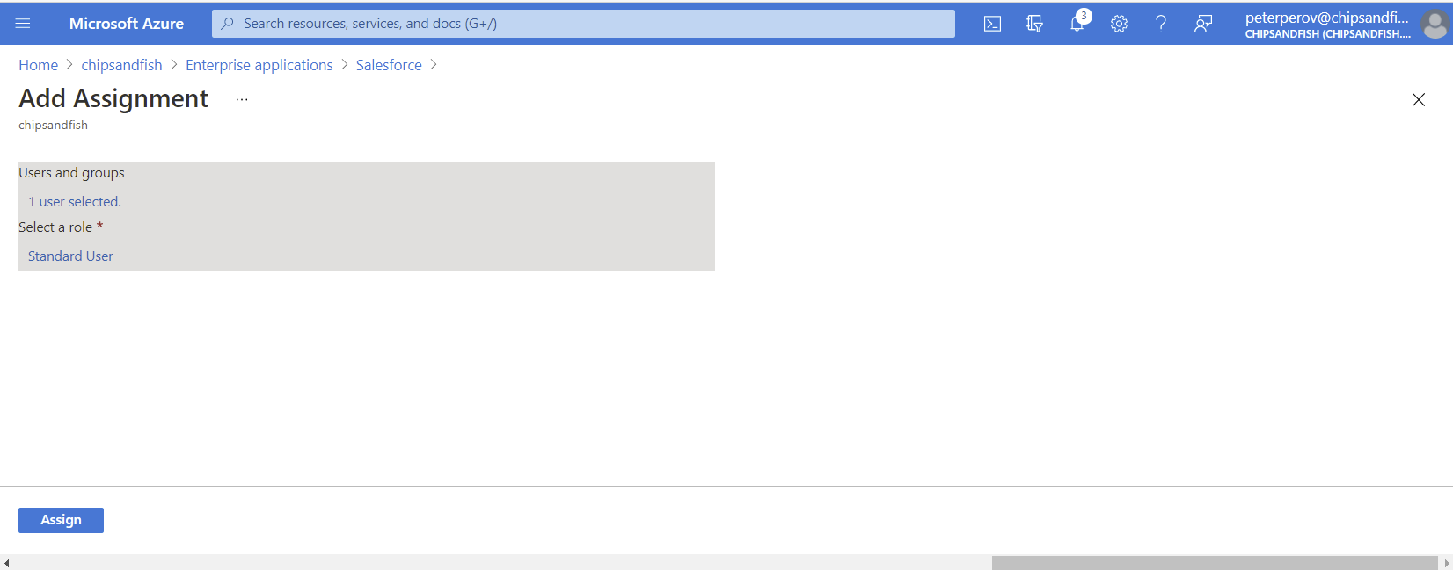

Slide 16
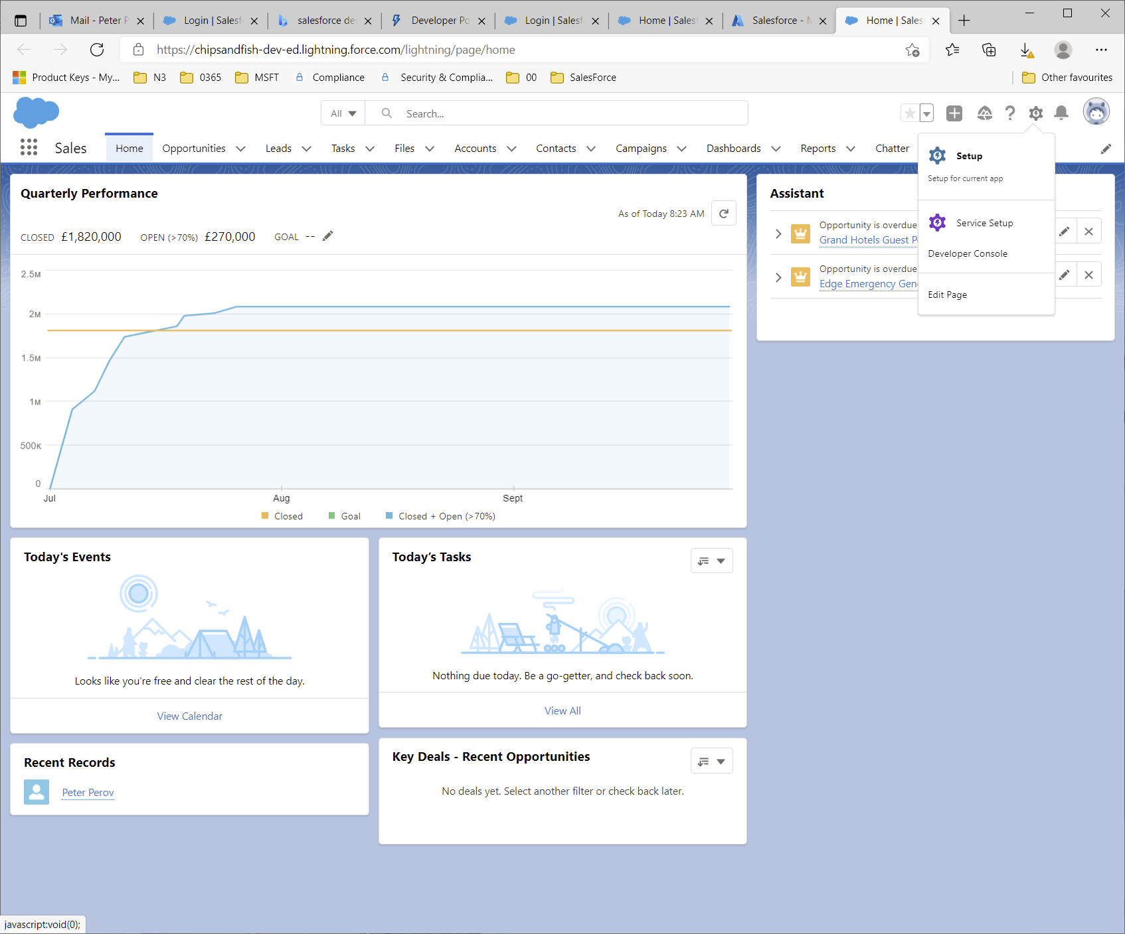

Slide 17
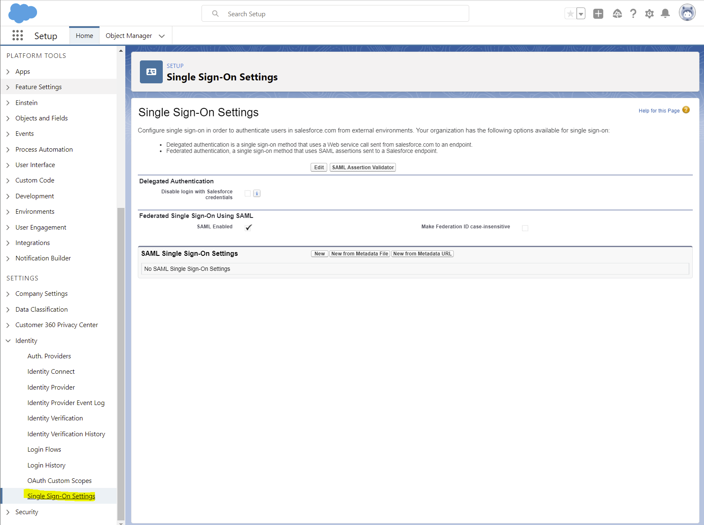

Slide 18
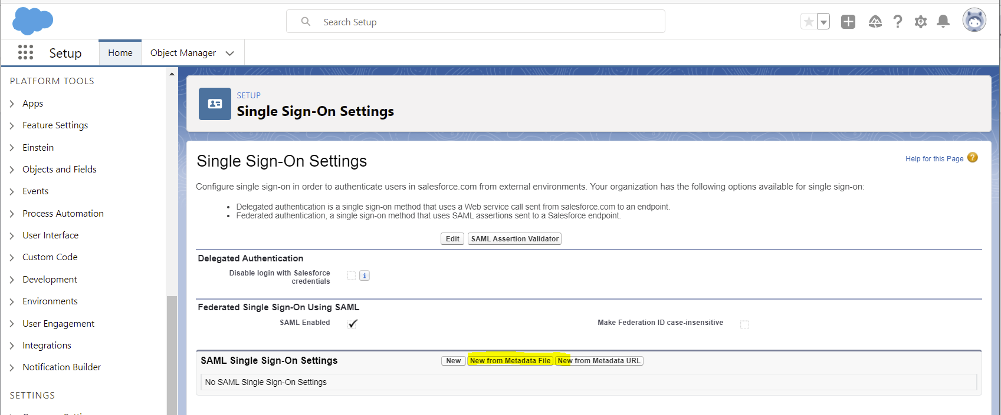

Slide 19
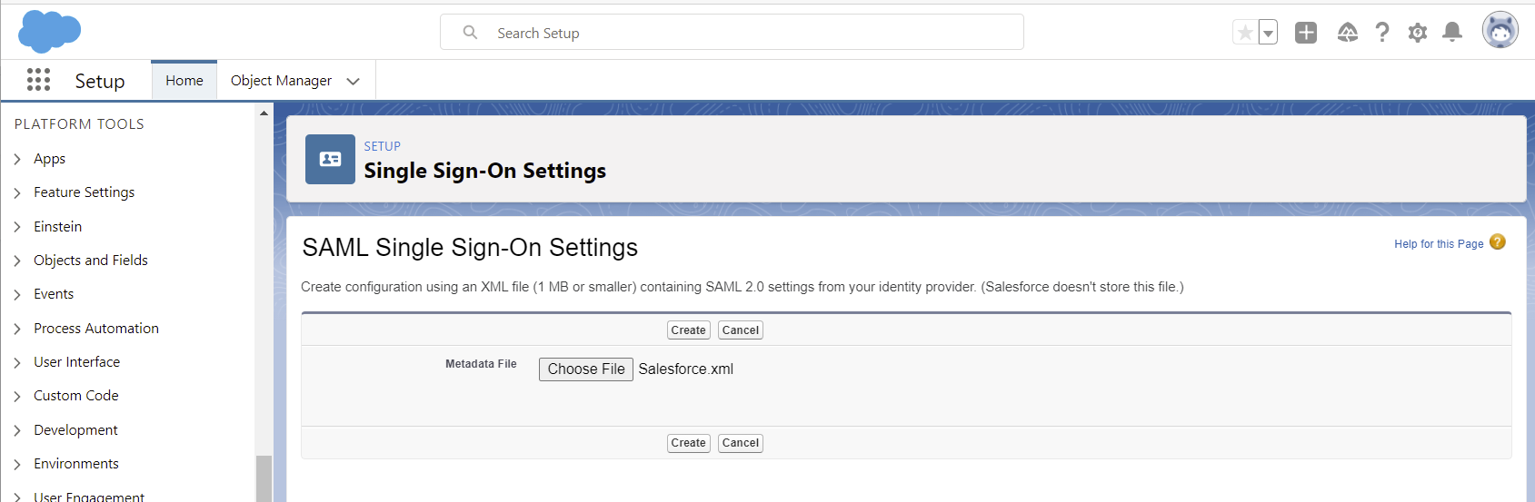

Slide 20
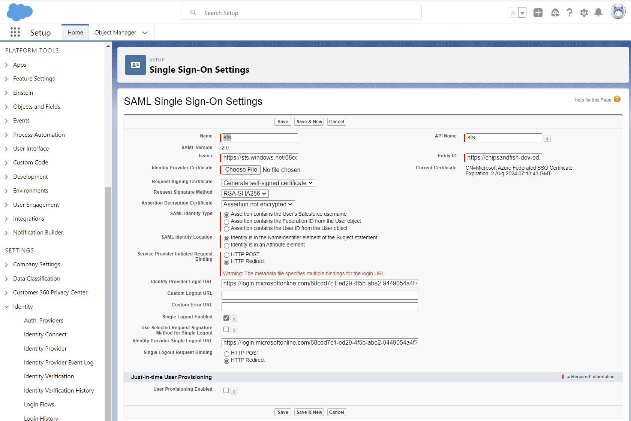
Click Save

Slide 21
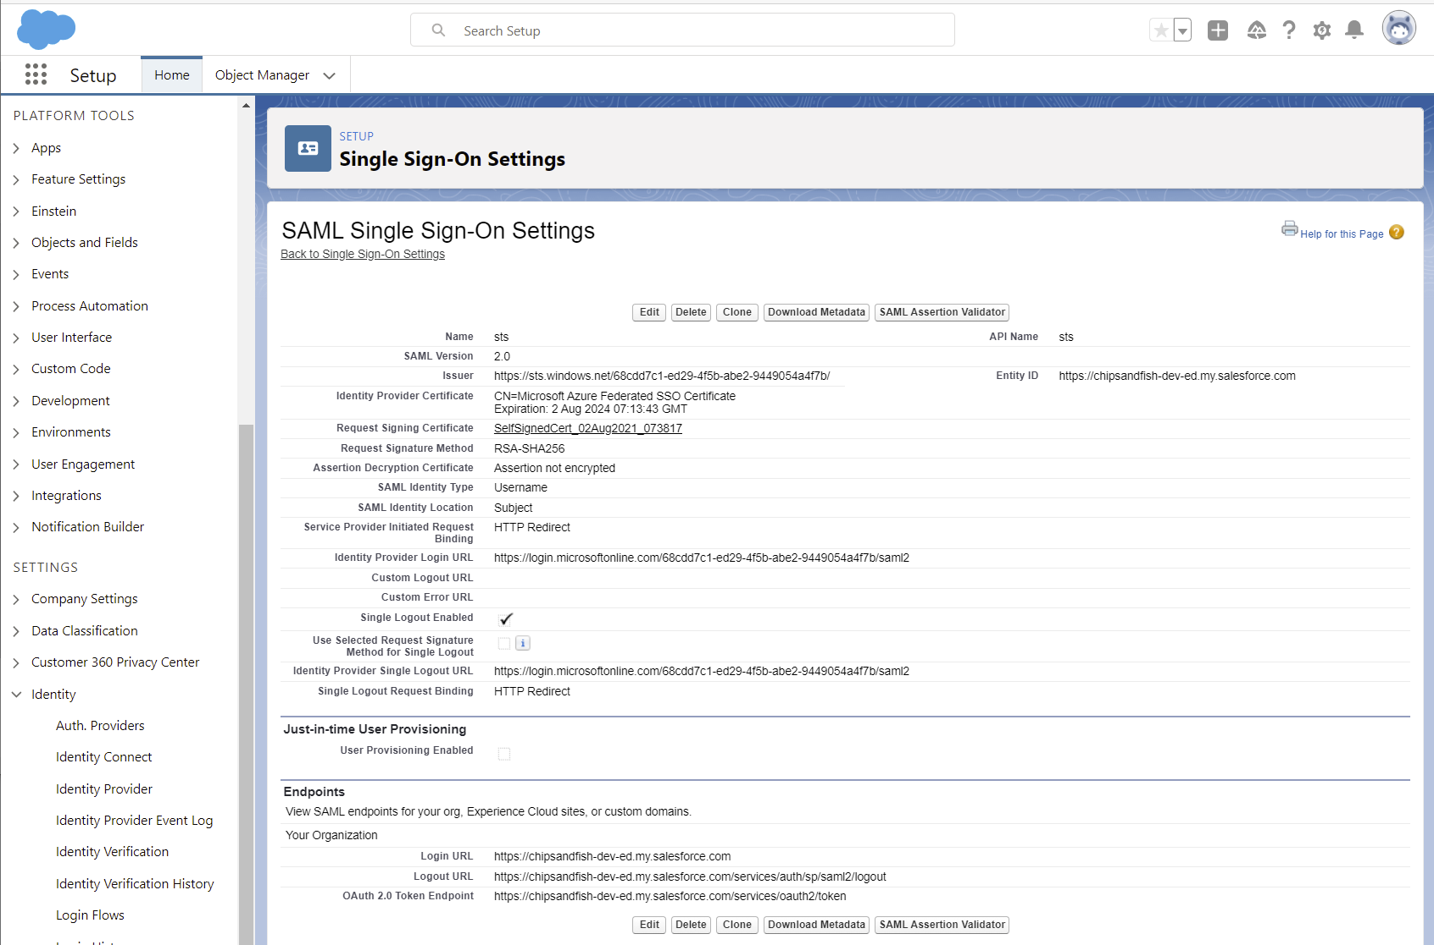
Saved

Slide 22
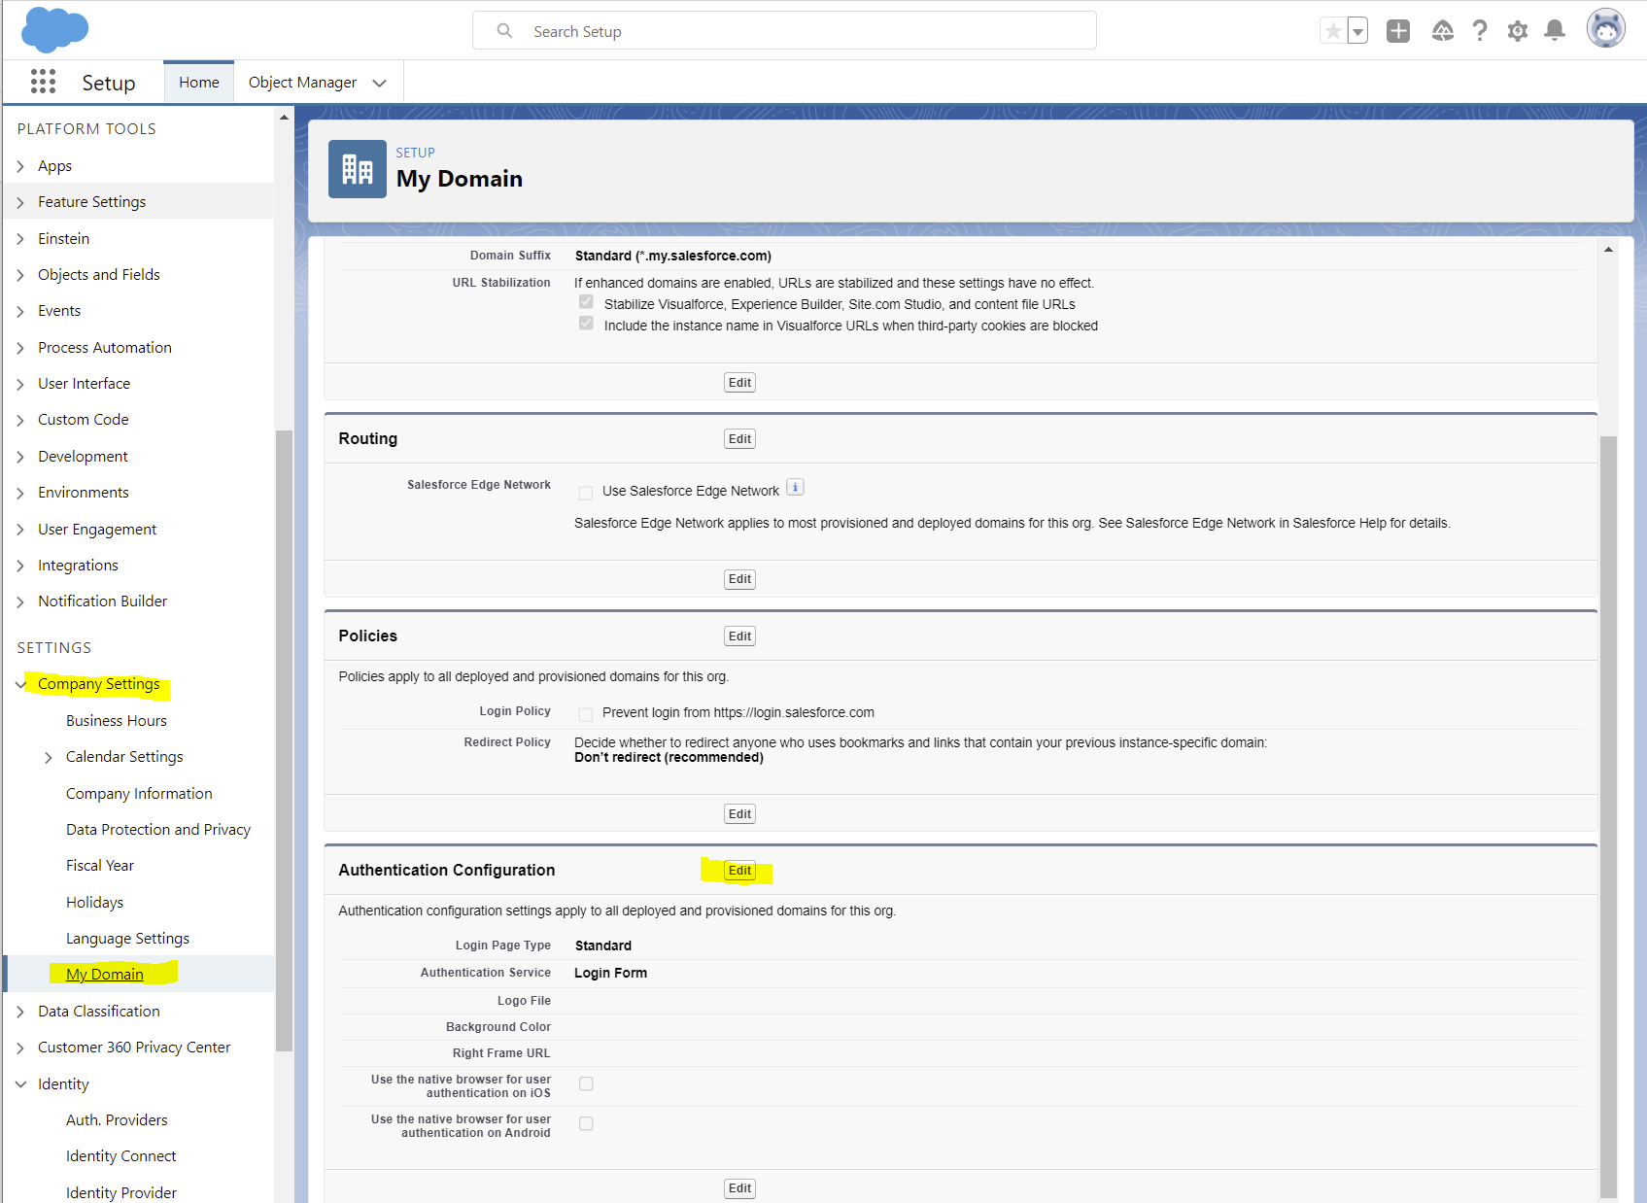

Slide 23
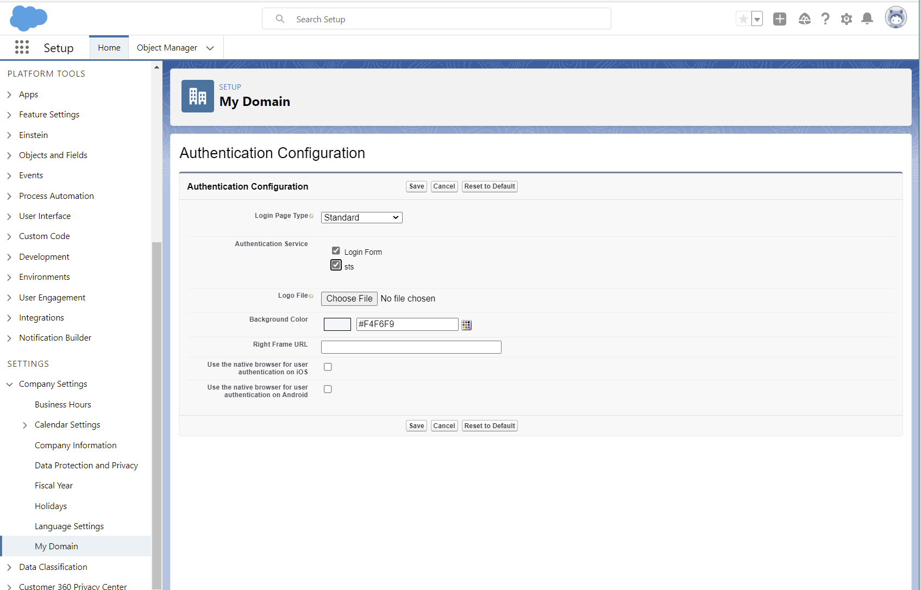

Slide 24
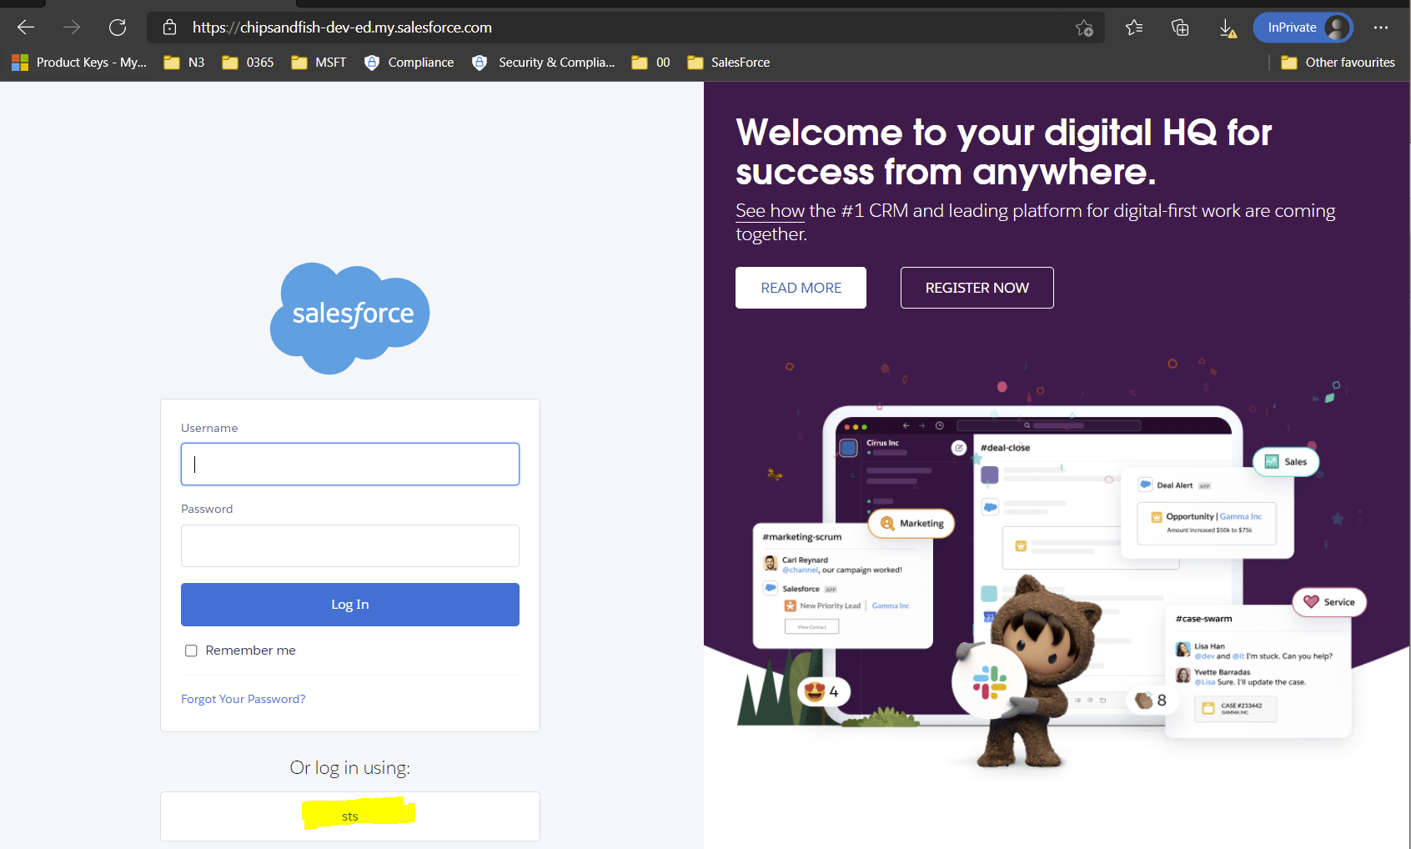
Notes:
New InPrivate Session
https://chipsandfish-dev-ed.my.salesforce.com/

Slide 25
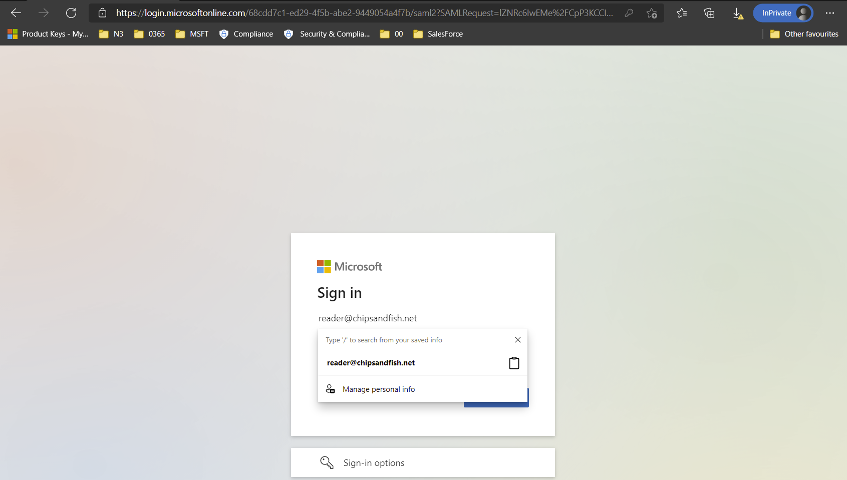
Standard AAD flow

Slide 26
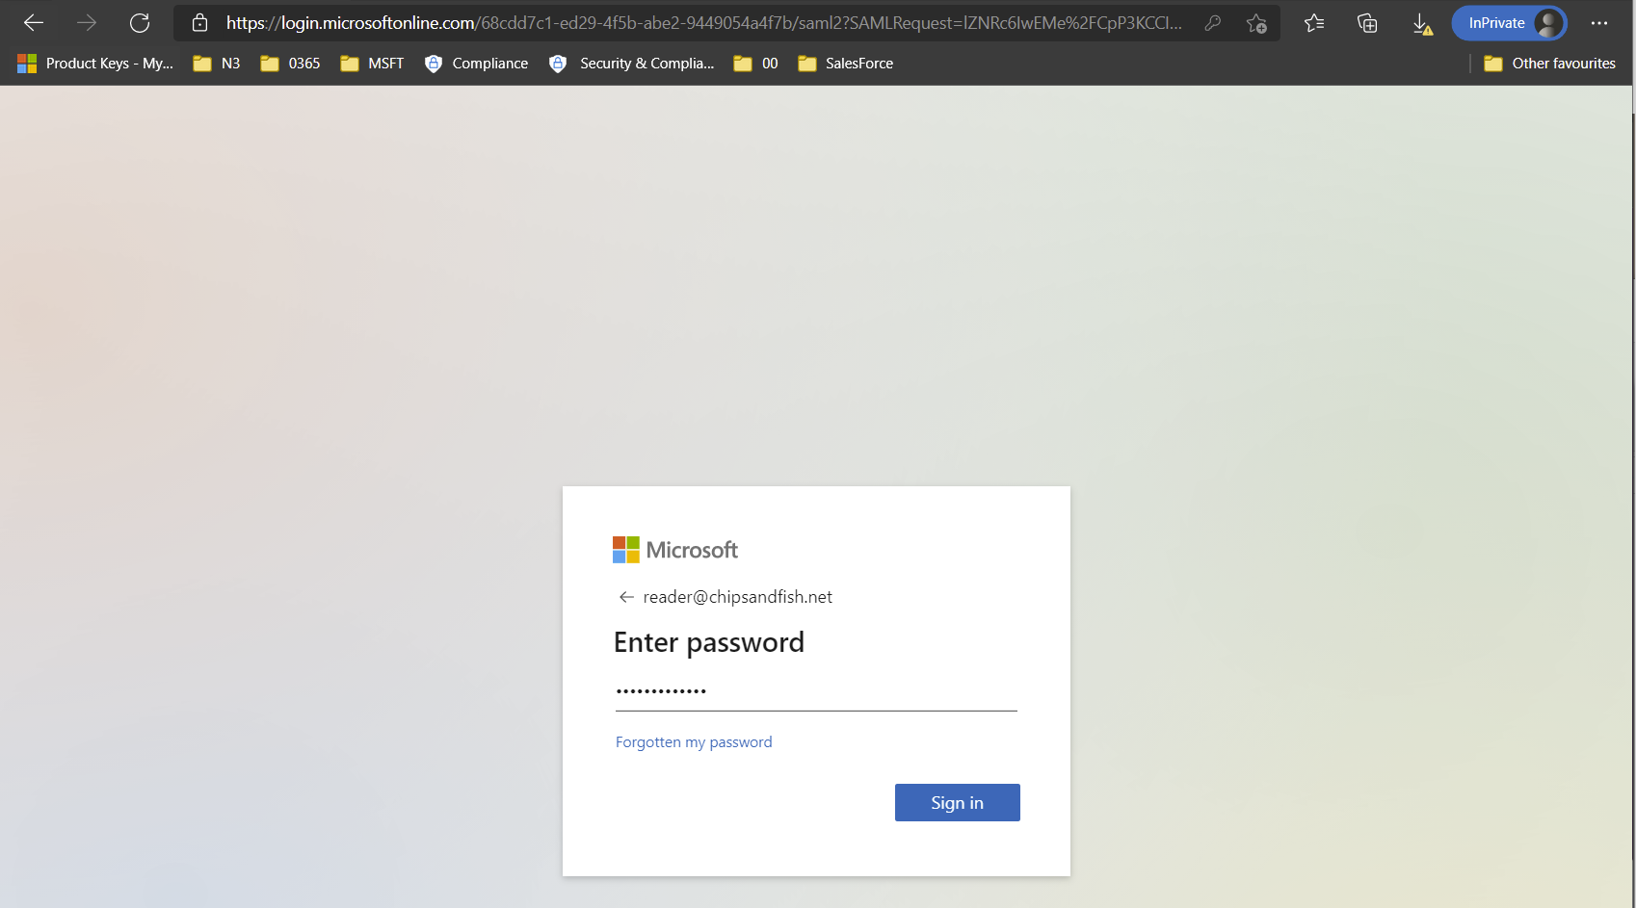
Standard AAD flow password

Slide 27
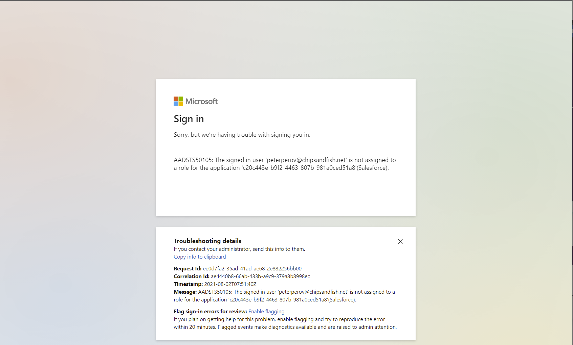

Slide 28
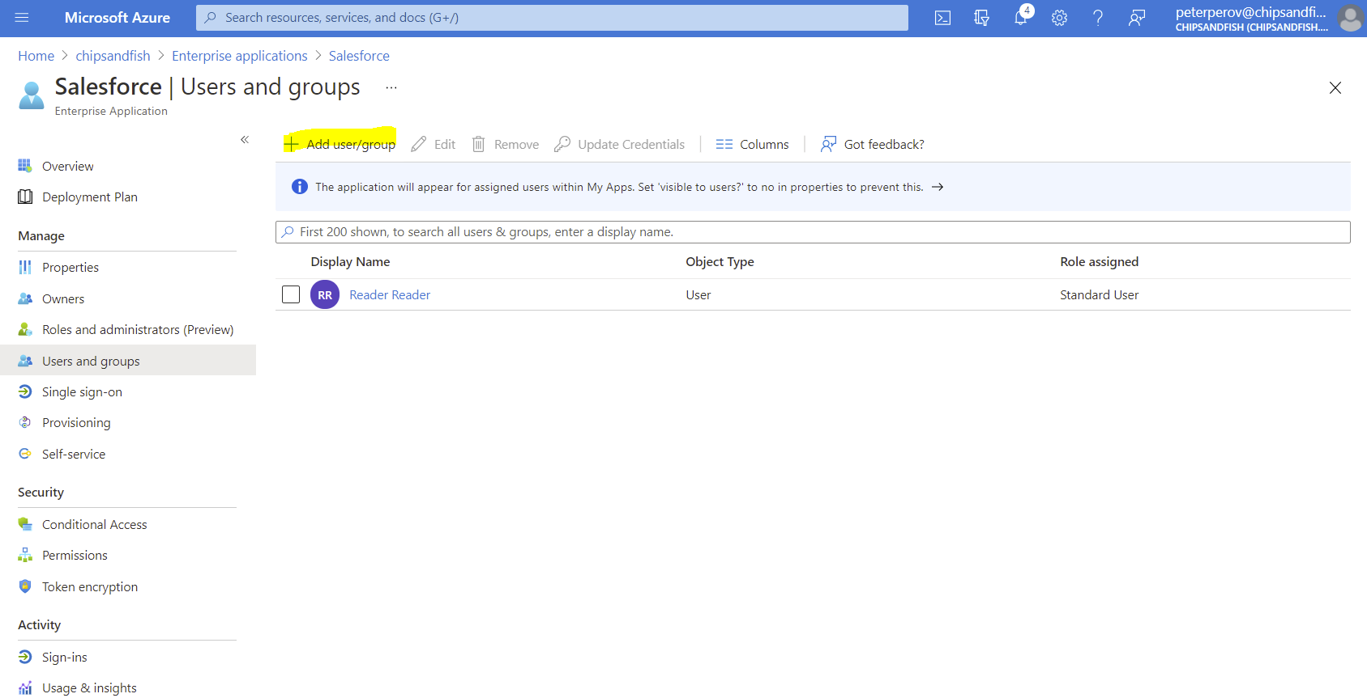

Slide 29
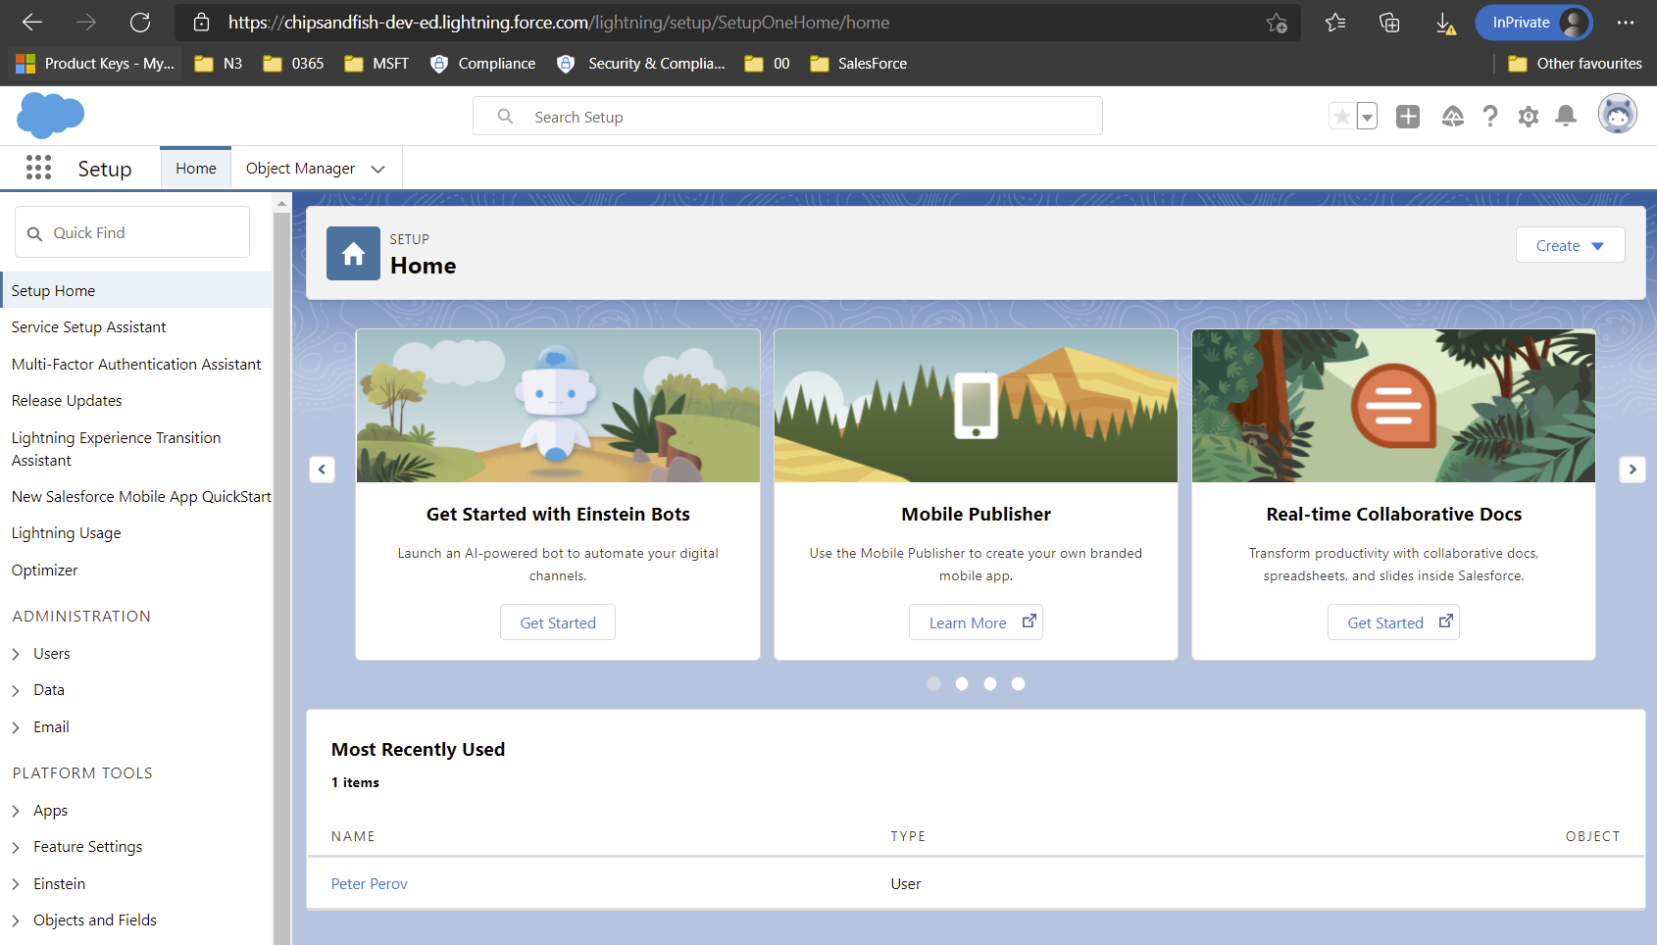
Works after adding a user

Slide 30
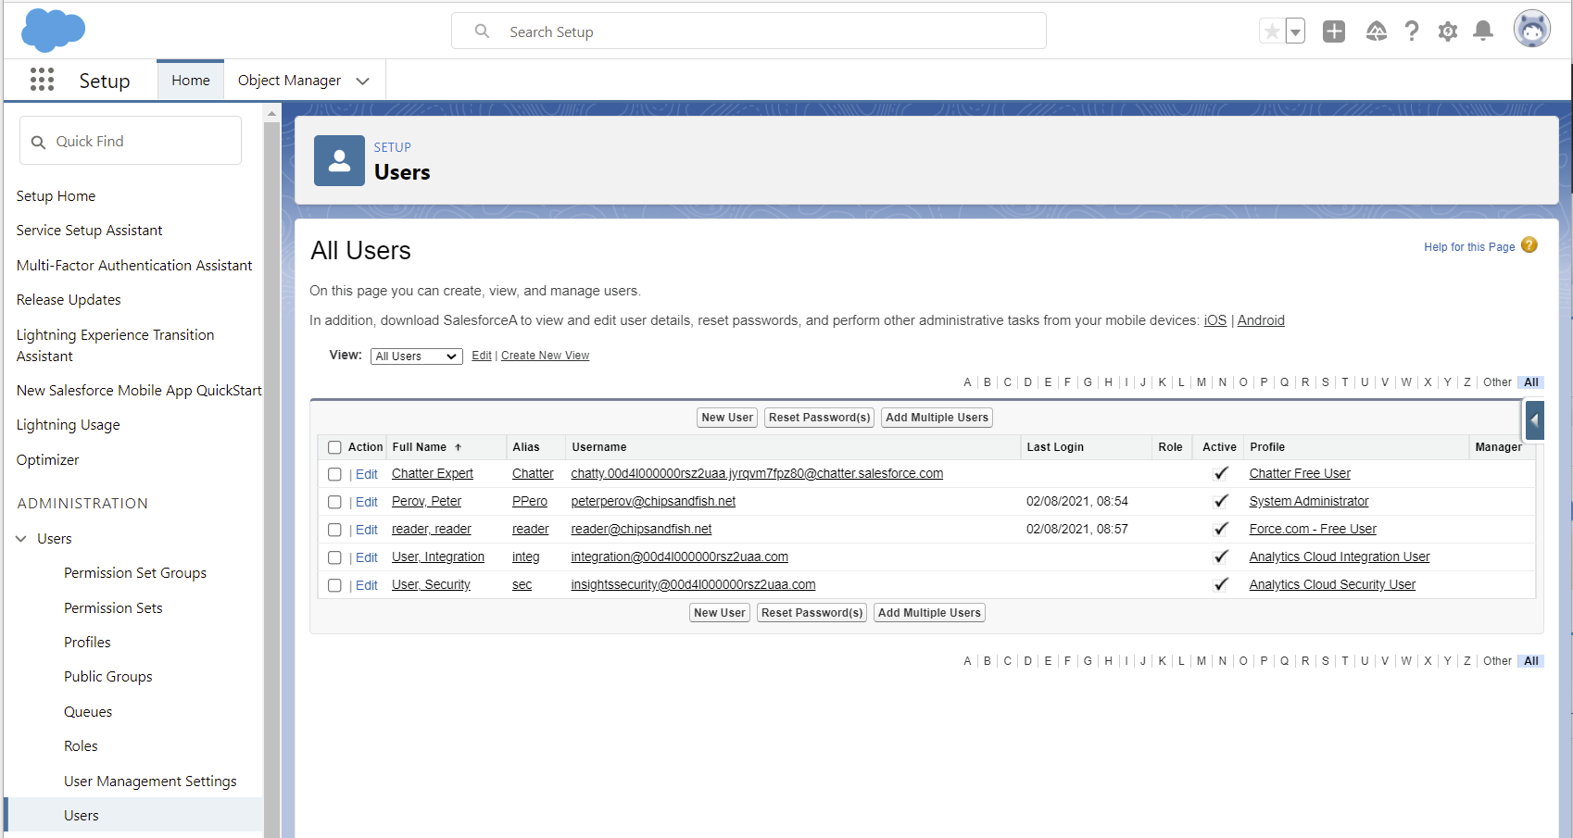
User reader could not login

Slide 31
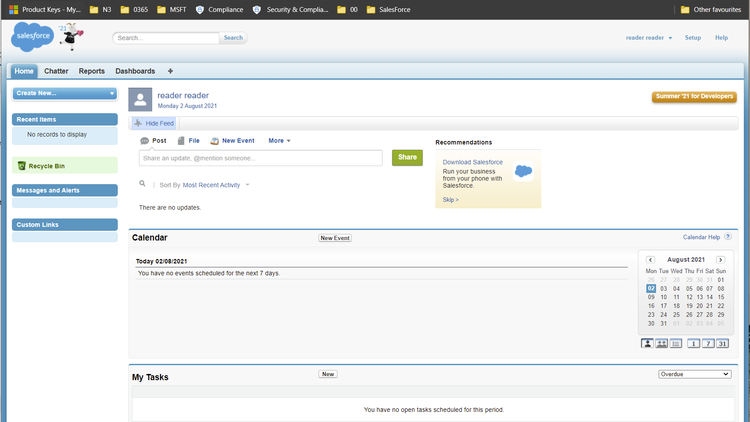
Created user in SF portal, user can login

Slide 34
Tutorials
https://docs.microsoft.com/en-us/azure/active-directory/authentication/howto-mfa-mfasettings

Slide 35
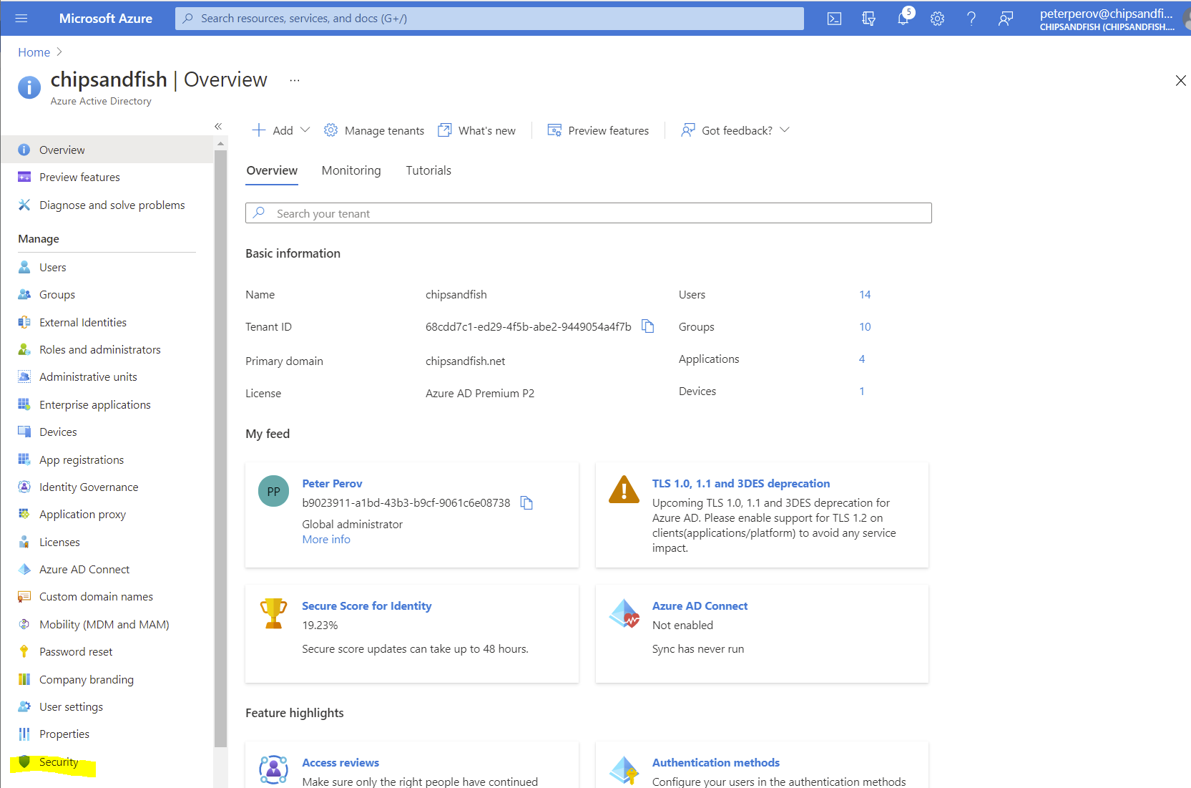
Azure AD in Portal

Slide 36
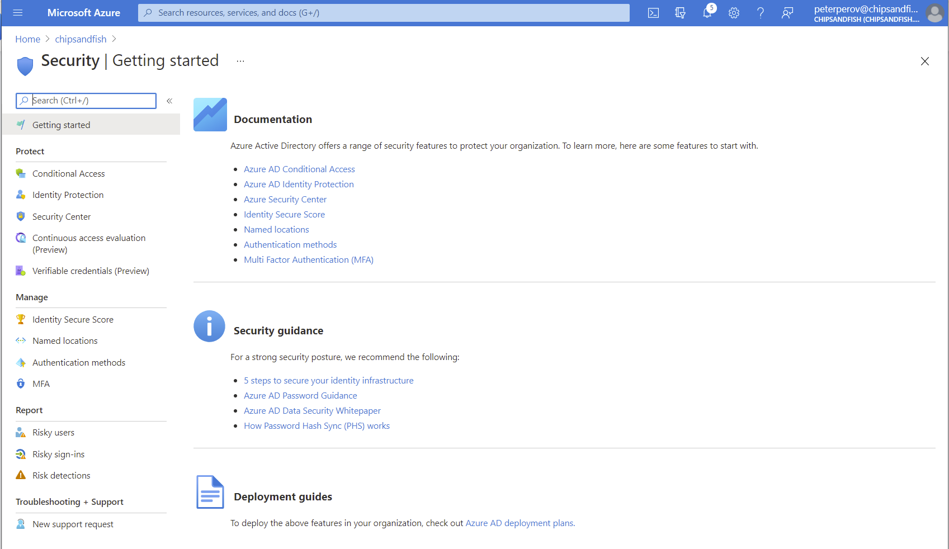

Slide 37
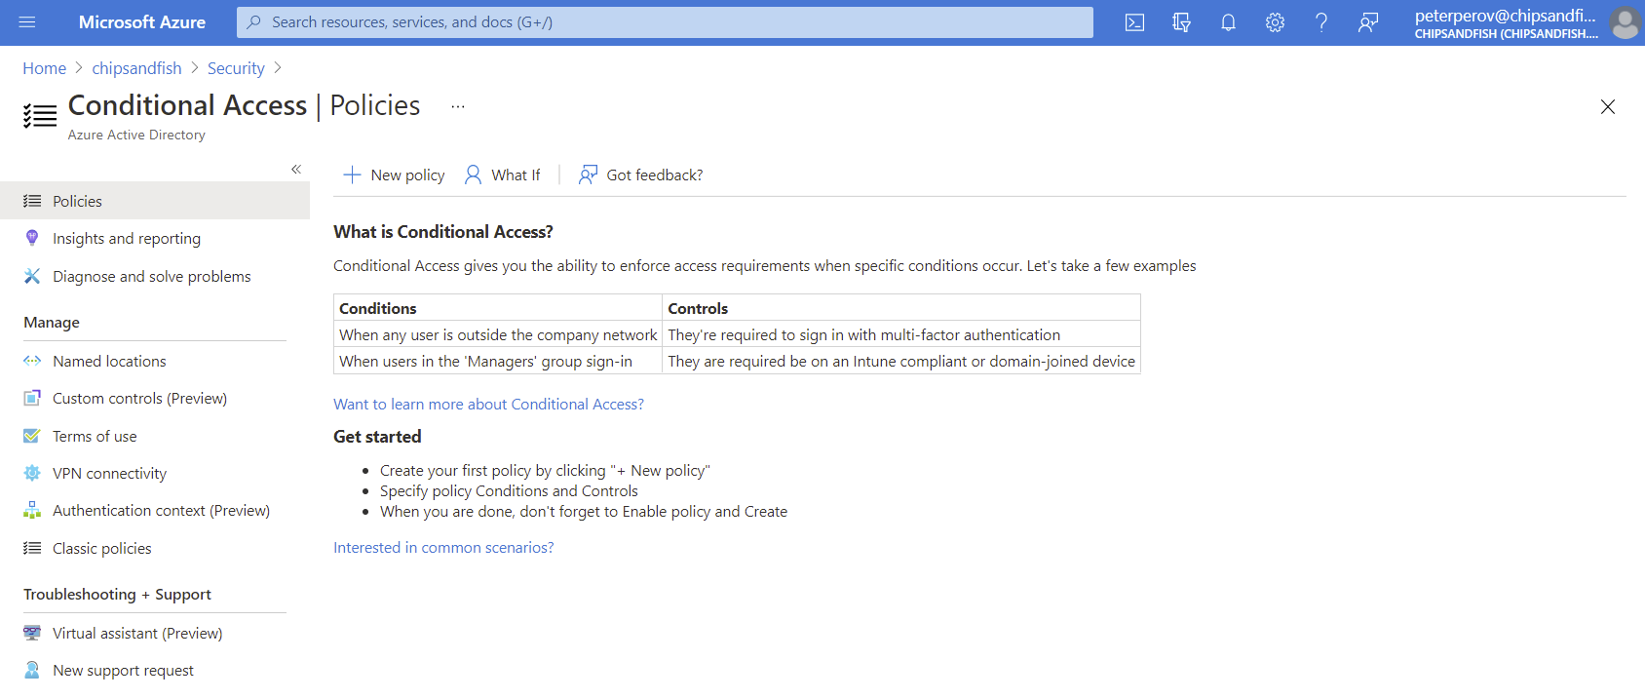
New Conditional Access Policy

Slide 38
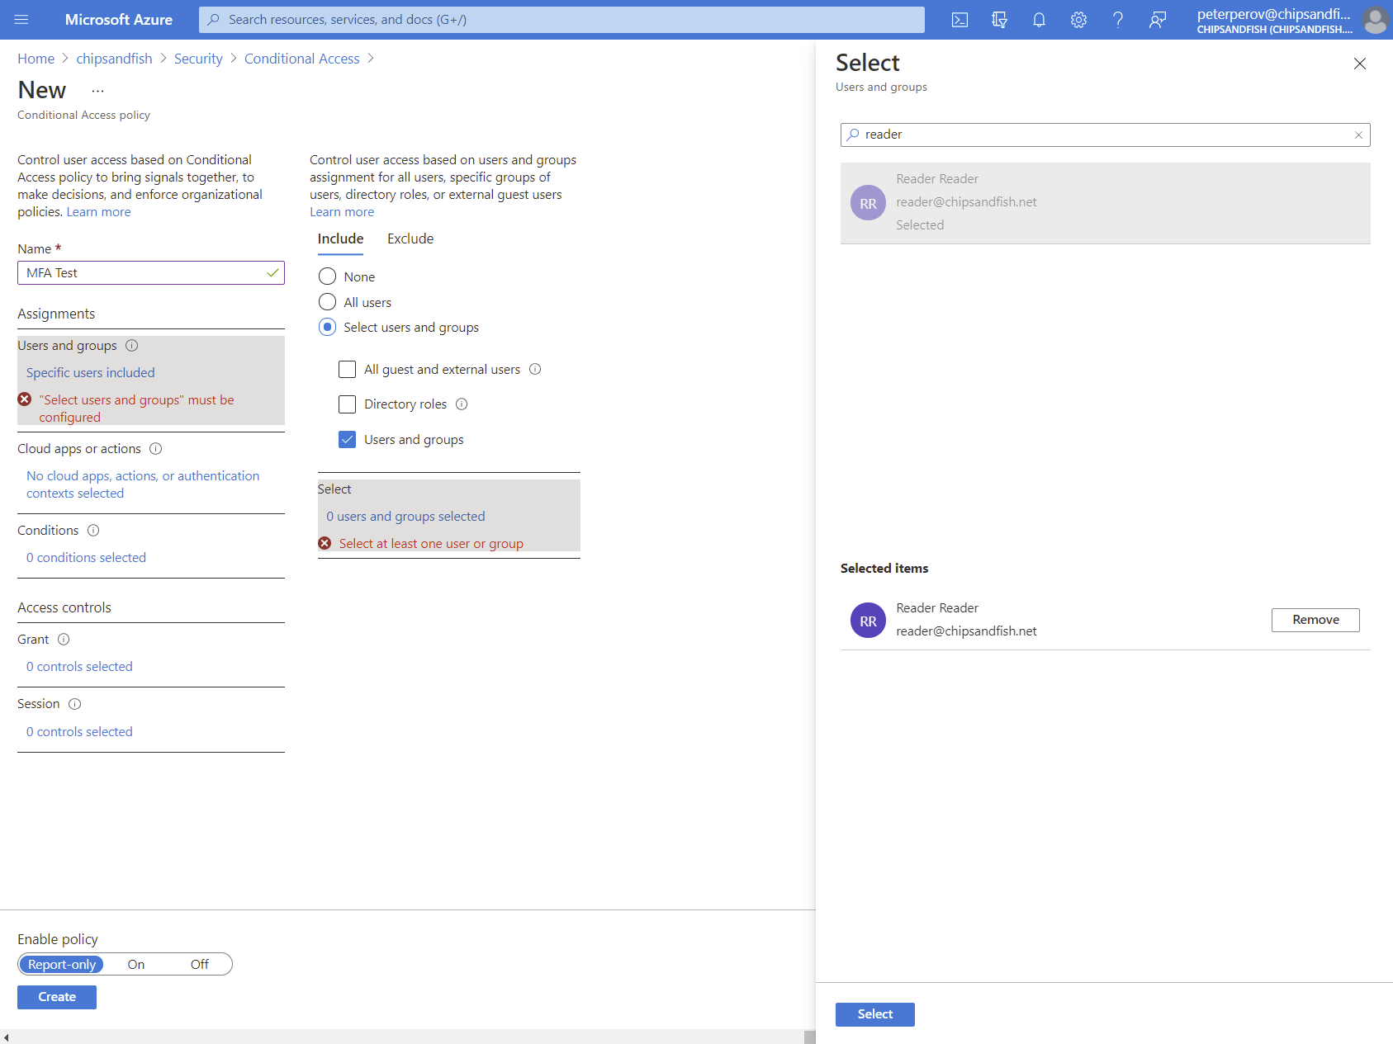

Slide 39
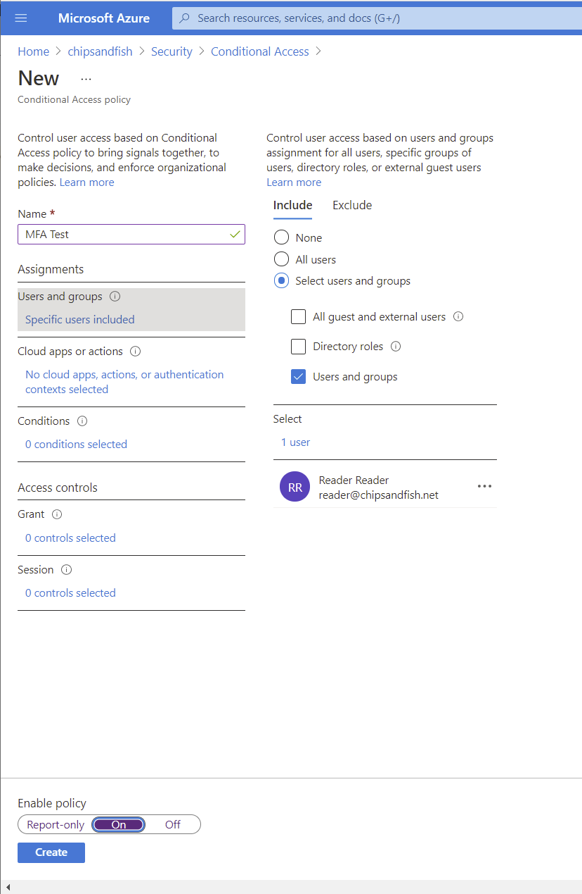

Slide 40
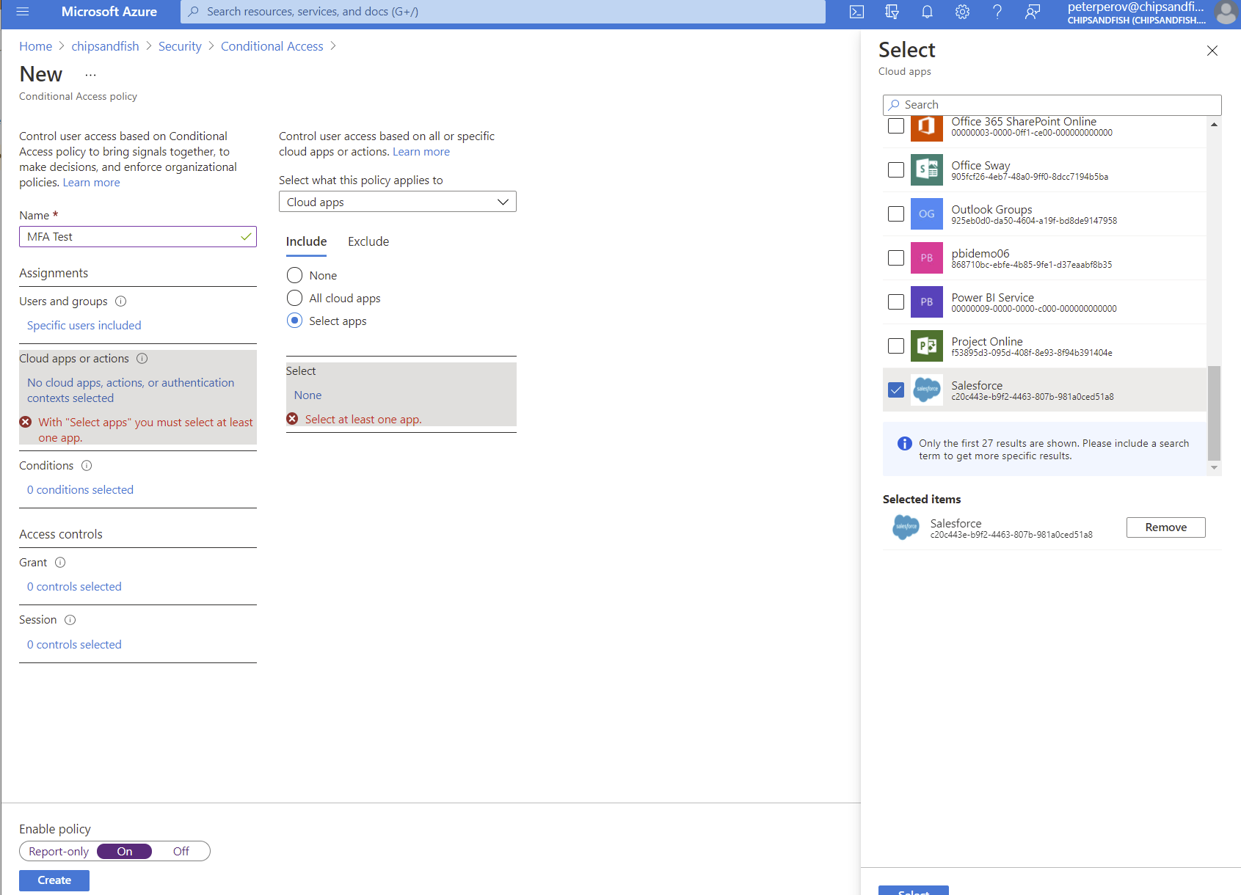
Add Salesforce app

Slide 41
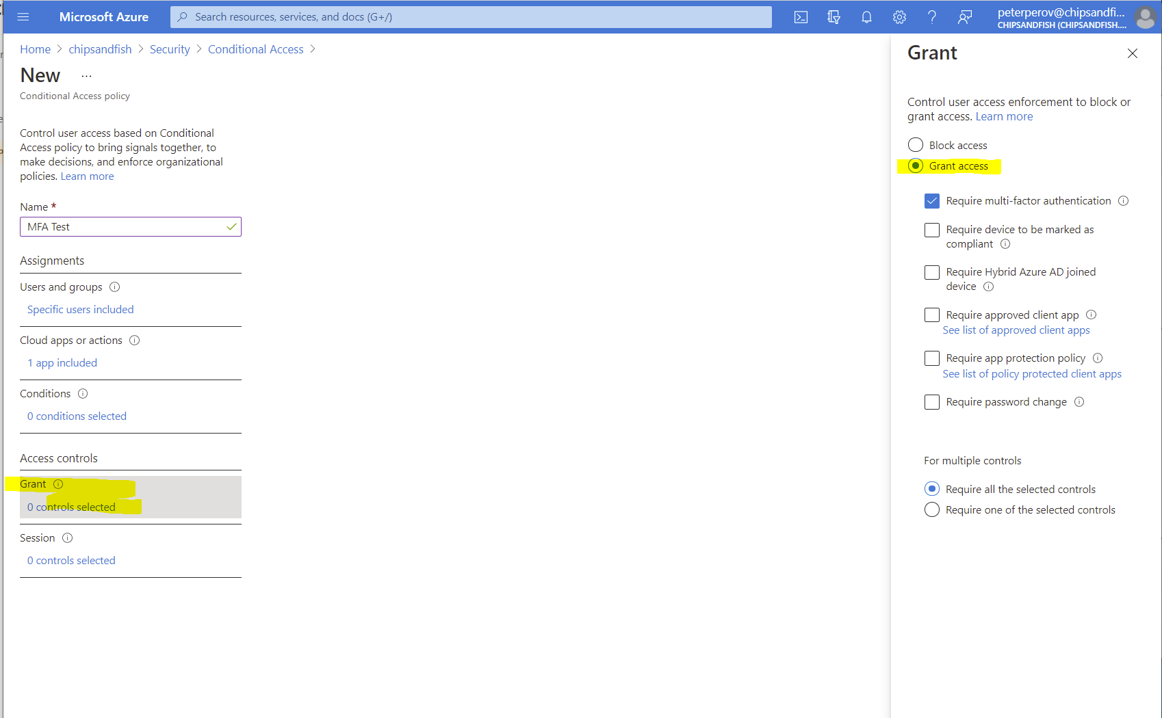
Enforce MFA

Slide 42
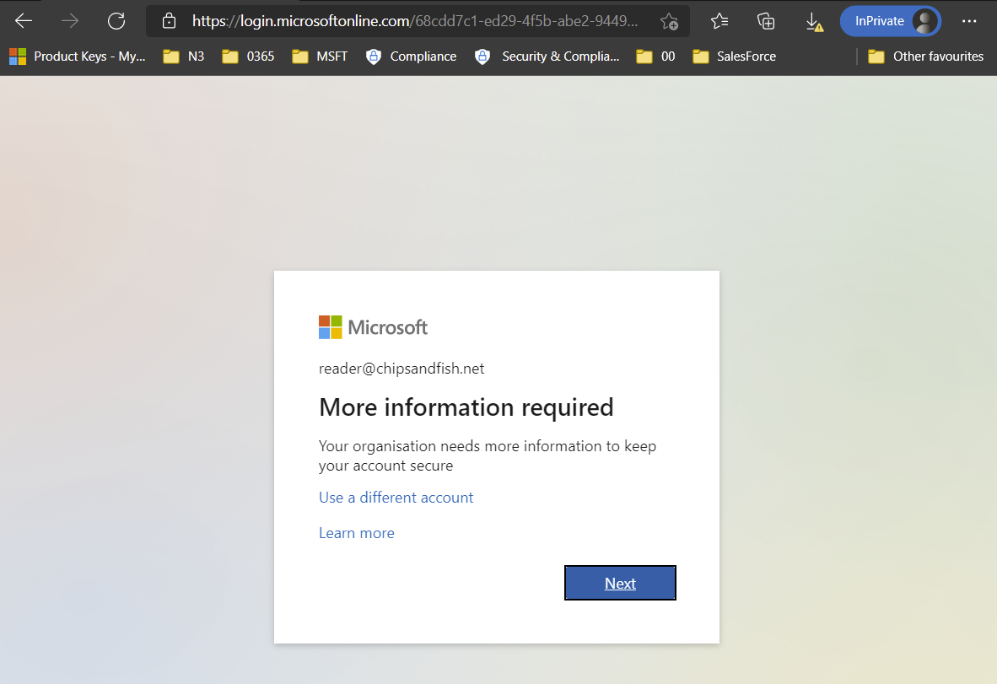
Trying to login – MFA required

Slide 43
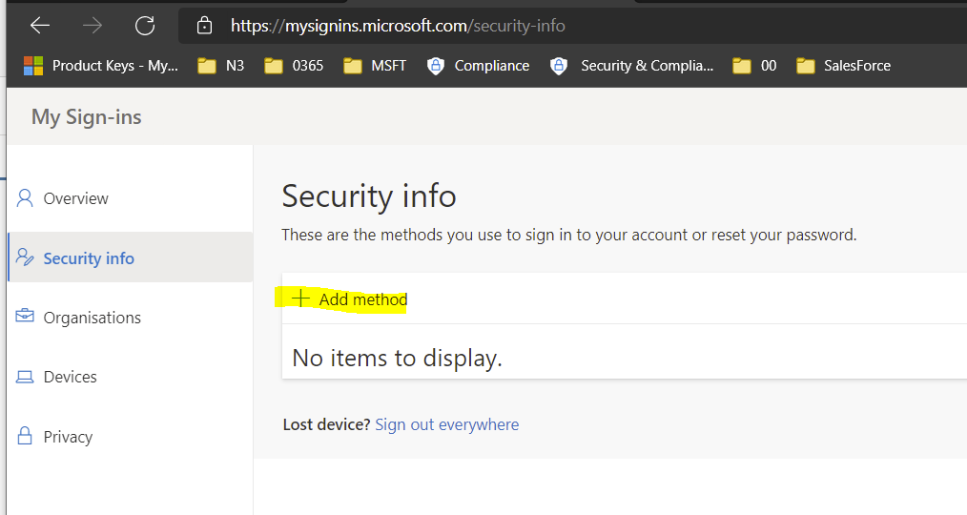
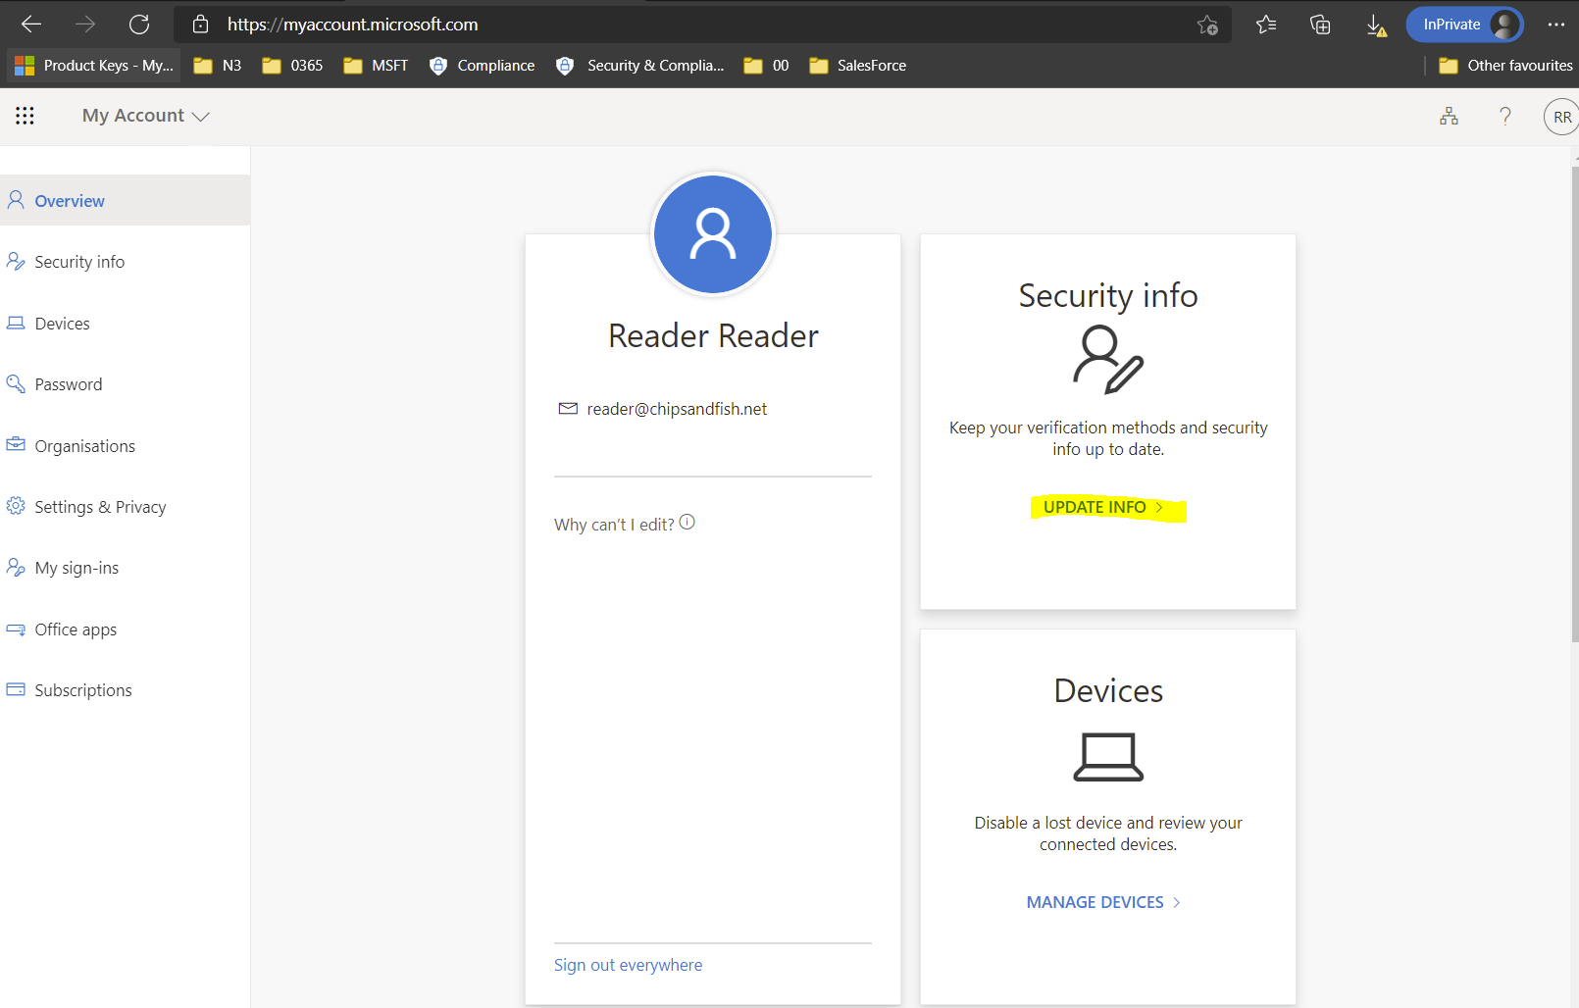
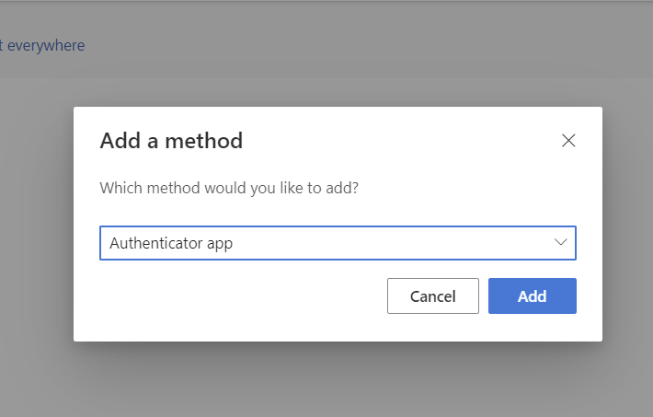
Register device
Notes:
https://myaccount.microsoft.com/?ref=MeControl

Slide 44
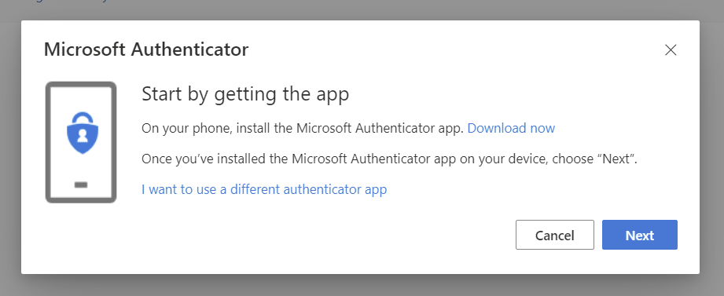
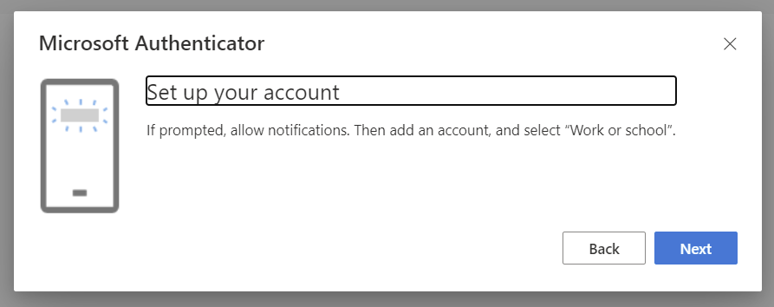
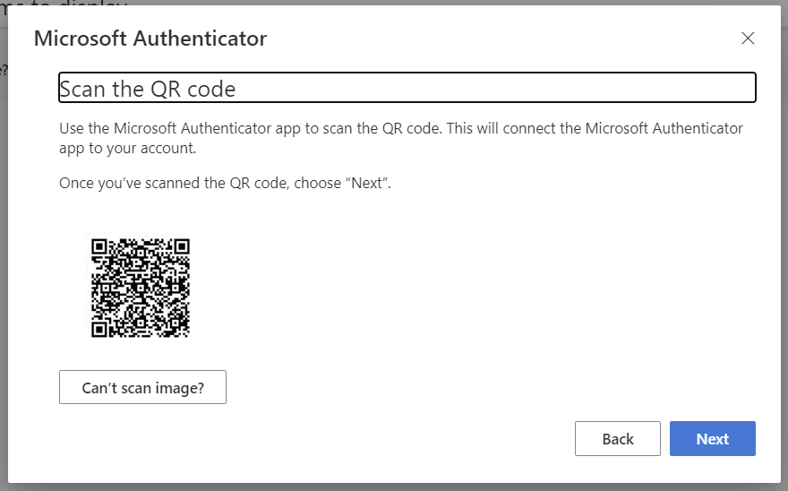

Slide 45
Links
Tutorial: Azure Active Directory single sign-on (SSO) integration with Salesforce https://docs.microsoft.com/en-us/azure/active-directory/saas-apps/salesforce-tutorial
Set Up Single Sign-On for Your Internal Users https://trailhead.salesforce.com/en/content/learn/modules/identity_login/identity_login_sso
Notes:
https://docs.microsoft.com/en-us/azure/active-directory/saas-apps/salesforce-tutorial
https://trailhead.salesforce.com/en/content/learn/modules/identity_login/identity_login_sso

